Slide 1
Optional Practical Training (OPT) and next step workshop

Slide 2
this tutorial is for instructional purposes only
An OPT application to USCIS is your own personal application. You alone are responsible for timely filing with full documentation, understanding of F-1 rules regarding OPT and properly maintaining F-1 status.
Please review entire tutorial and contact OISS for any questions
Consult Immigration Attorney if necessary

Slide 3
outline
What is OPT?
OPT Eligibility and application process overview
Check your I20 for Accuracy
Top OPT Denial Reasons
Receiving your I-797C receipt notice
Employment Requirements
Completing OPT & Grace Period
TRANSFER
RETURNING HOME

Slide 4
What is OPT?
Optional practical training is an F-1 student employment benefit that allows for off campus work authorization in a student’s major field of study.
Initial OPT is for 12 full months
STEM (science, technology, engineering and mathematics) OPT is for an additional 24 months of work authorization

Slide 5
Opt eligibility
Student has or will complete all graduation requirements before the end date on I-20
Has not used more than 12 months of Full-time CPT
Heavy CPT usage either part-time or full-time can cause your OPT application to be subject to additional scrutiny. Be prepared to provide evidence of all prior CPT I-20s, as well as the academic work related to your CPT
NOTE: On-campus employment does not count toward CPT or OPT
OPT cannot be used for the same Education level twice

Slide 6
Application oVerview
Students may apply for OPT either 90 days prior to their program end date OR within their 60 day Grace Period
Step1
- Gather all necessary documents (please review handout)
- Make appointment with OISS to review documents, application form (I-765) and to discuss new I-20 with OPT recommendation
Step 2
- Choose your OPT Start Date

Slide 7
Choose your OPT Start Date
Your OPT start date is the date that your 12 months of work authorization begins.
Your OPT start date must be within your 60-day grace period after the program completion date.
The end date will usually be 1 year from your start date (i.e. a July 2 start date will have a July 1 end date.)
DON’T WAIT until you get a job offer to apply for OPT or select your dates. Estimate when you would like to be available to work, and choose that start date. If you wait for an offer, you may not be able to apply for OPT in time.
The requested start & end dates will be noted on page 2 of the new OPT I-20.
NOTE: Once your OPT application has been submitted, you cannot change your start date

Slide 8
Check your I-20
OPT job placement is based on your major of study
Check your I-20 for your Major (OPT can only be issued for your Major not your Minor)
Check your overall program end date. If it does not match your class end date, please contact OISS to update your document with the correct end date

Slide 9
Mailing your OPT application
Once all necessary documents are verified, you have 30 days to mail your application to the Processing Center from the day OISS issued the new I-20
Best option for mailing is Express Mail (FedEx, UPS, etc.)
USCIS
Attn: AOS
1820 E. Skyharbor Circle S
Suite 100
Phoenix, AZ 85034
For text and email notifications regarding your application please attach Form G-1145 to documents https://www.uscis.gov/sites/default/files/files/form/g-1145.pdf

Slide 10
Top opt denial reasons
Payment Issues
- Check or Credit Card payment: Money is not in account at time of processing
– incorrect fee amount
– Check or money order form not completed properly
– Wrong dates on check, money order (U.S Date style = MONTH/DAY/YEAR = MM/DD/YYYY)
Application received too late
- USCIS must receive application no later than 30 days after OPT recommendation
I-765 problems
- Incomplete or incorrect fields
- Not signed
NOTE: if your application is denied please contact OISS immediately

Slide 11
Receiving your I-797C Notice of Action
You should receive the notice by mail within 2-4 weeks after mailing the OPT application to USCIS. Please update OISS with your current mailing address.
The I-797C is very important. If you lose the receipt, it may be very difficult to replace it.
The I-797C is necessary if you want to:
inquire about the status of your OPT application.
travel outside the U.S. while your OPT is pending.
Receiving the I-797C does not grant you work authorization. You must still wait to receive your EAD Card prior to any employment

Slide 13
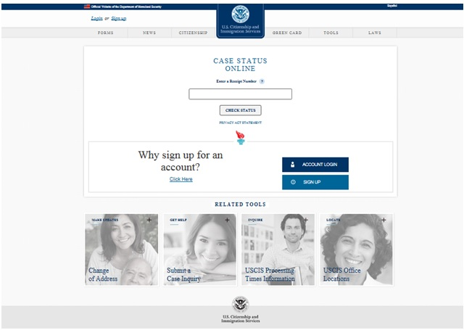
Receipt Number
The case number for the OPT application at USCIS. Check the status of the case on the USCIS web site at https://egov.uscis.gov/casestatus/landing.do

Slide 14
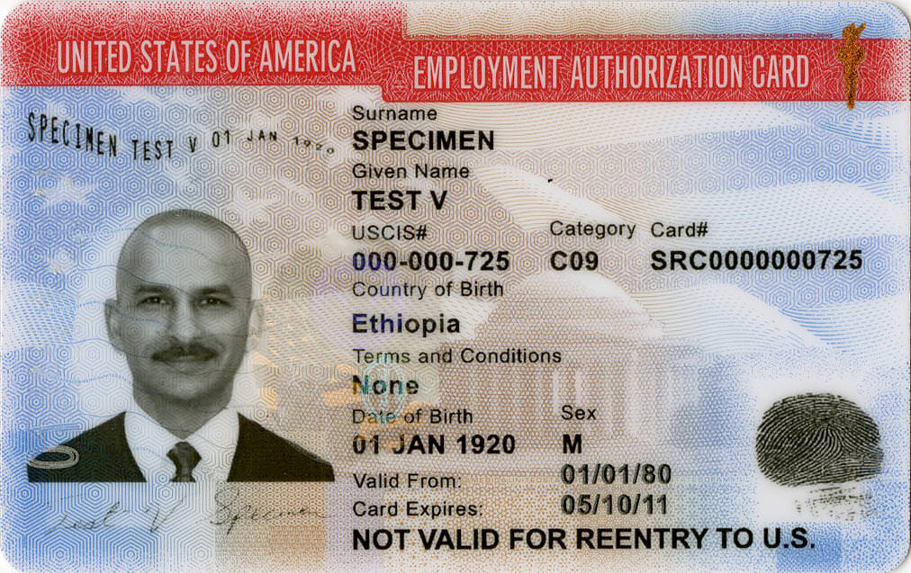
Employment authorization Document (ead card)
Review your EAD card to make sure the information is accurate. If it is not, contact OISS
Present your EAD to employers as proof of your legal work authorization in the US.
The EAD is a required document for entry to the U.S. during OPT

Slide 15
Employment requirements
You must work a minimum of 20 hours per week in a position related to your field of study
You cannot exceed more than 90 days of unemployment while on OPT. It is your responsibility to keep records of your employment and any periods of unemployment.
If you accumulate 90 days or more of unemployment, you are in violation of your F-1 status. You are expected to leave the U.S., transfer to another school, or change your visa status before the 90th day
Cannabis Industry - be aware that use and sale of cannabis is illegal at the federal level, although it may be legal in some U.S. states. To avoid possible deportation or inadmissibility form the U.S., students should avoid positions related to federally illegal substances.

Slide 16
Sevp portal account
There are four basic steps for creating an account in the SEVP Portal:
1. SEVIS notifies the SEVP Portal of U.S. Citizenship and Immigration Services’ (USCIS) approval of the student’s OPT or practical training and the OPT authorization is active; the portal emails the student instructions for creating a portal account.
2. Student receives the email which contains a link they must use to create the account. This link is unique to the student and cannot be shared or reused.
3. Student clicks the link in the email, enters their SEVIS ID and creates a password.
4. The SEVP Portal creates the student’s user profile.
*please update your email address with OISS during OPT appointment*
https://studyinthestates.dhs.gov/create-an-sevp-portal-account

Slide 17
Types of employment
Paid employment
Multiple employers
Work for hire (commonly referred to as 1099 employment)
Self-employed business owner
Employment through an agency
Unpaid / Volunteer employment

Slide 18
Completing opt & grace period
You have a 60 day grace period following the end of the OPT EAD.
• Failure to exit, continue your F-1 status, or timely file an Extension or USCIS Change of Status will result in accrual of days of unlawful presence.
• If you intend to apply for an OPT STEM Extension, you must do so before the expiration of your 12 month OPT (can apply 90 days prior to OPT ending)
• The only additional extension of OPT available is the OPT Cap Gap Extension, for students who have an accepted cap-subject H1-B application.
• If you receive an Extension of your OPT, the grace period will begin after the end of the Extension period.
If you do not extend your OPT, and your EAD expires, you have the following options before the end of the 60 days grace period:
1. Exit the US within 60 days
2. Continue your F-1 Status & Studies: Transfer your I-20 to continue studies at another school OR request a Change of Educational Level to begin new studies at UOR
3. Work with immigration legal counsel regarding a Change of Status application to a new visa category. You will need to check with your legal counsel regarding your allowed period of stay or required exit date if you have a pending change of status when your grace period ends.

Slide 19
Transfer
Must see acceptance letter from new Institution (or UOR program) prior to release of SEVIS record
Submit transfer-in form to OISS to complete prior to release of record (if applicable)
Transfer must be within 60 day grace period after program ending to maintain an Active status in SEVIS
If you transfer during your OPT, the transfer will automatically void your OPT authorization
You will have 5 months or at next available term start to begin your new program (whichever is sooner)

Slide 20
Returning home
Must exit US before or on the last day of 60 day grace period
If you leave the US prior to end of 60 day grace period (Mexico/Canada count), you have forfeited your status and would need to return to the US under a new visa status

Slide 21
Additional information
For individual OPT counseling, please set an appointment with OISS
Rebecca Freeland
909-748-8716
Rebecca_freeland@Redlands.edu
Steve Wuhs
Steve_wuhs@Redlands.edu
Armacost Library, Room 100
For additional OPT information visit www.uscis.gov/opt
https://studyinthestates.dhs.gov/

