Slide 1
LOCATION, GIS, AND SPATIAL BIG DATA
Conceptual Foundations
Overview of Big Data and Analytics
Brian N. Hilton, Ph.D. Clinical Associate Professor Center for Information Systems and Technology Claremont Graduate University Brian.Hilton@cgu.edu | Rama Ramakrishna, Ph.D. Professor School of Business University of Redlands Hindupur_Ramakrishna@redlands.edu

Slide 2
Big Data and Analytics
The Big Picture

Slide 3
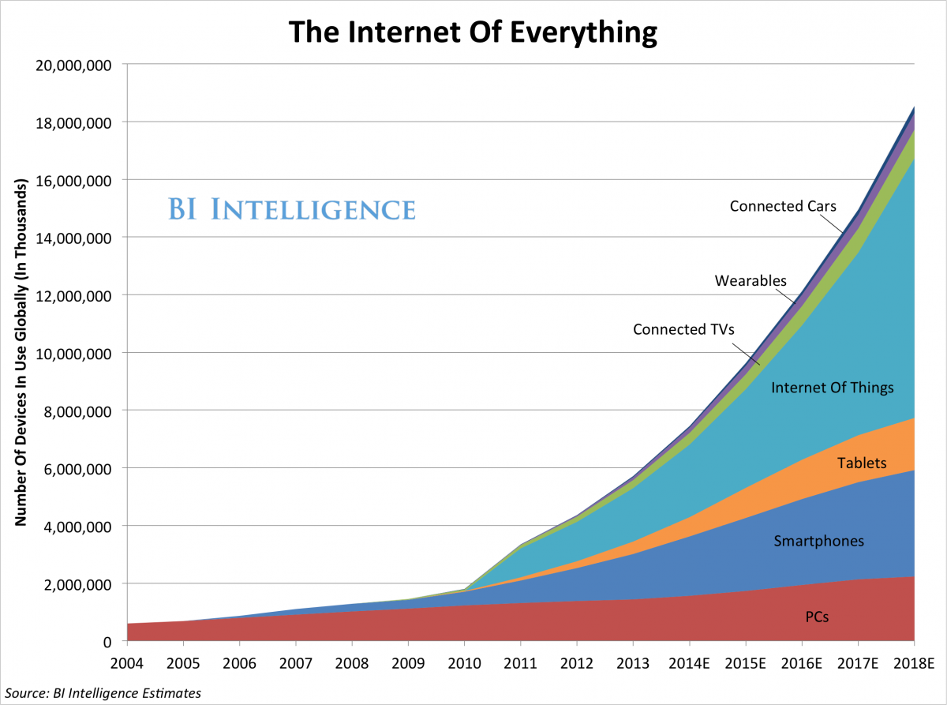
Internet of Everything
We’re About Here

Slide 4


Internet of Everything
It’s user generated content…

Slide 5
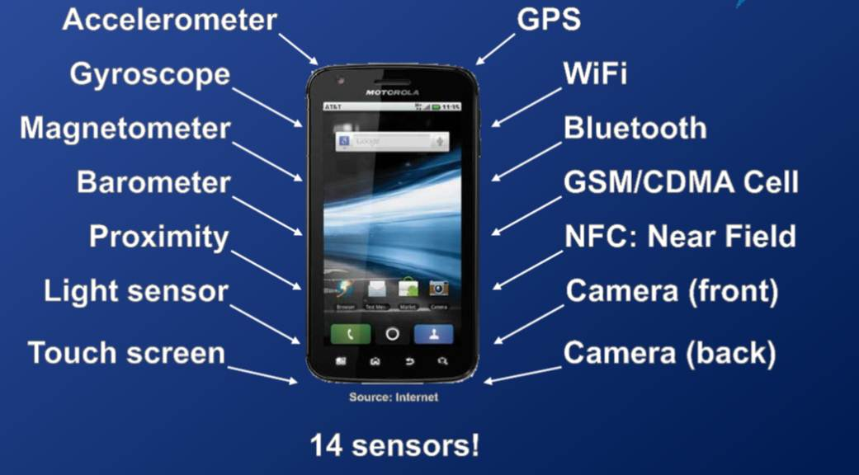
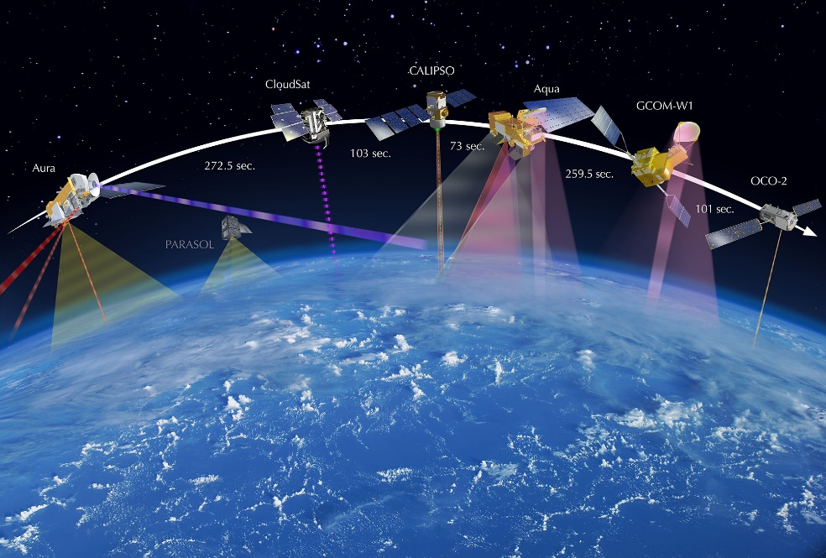



Internet of Everything
It’s sensor data…

Slide 6


Internet of Everything
It's connected data…

Slide 7
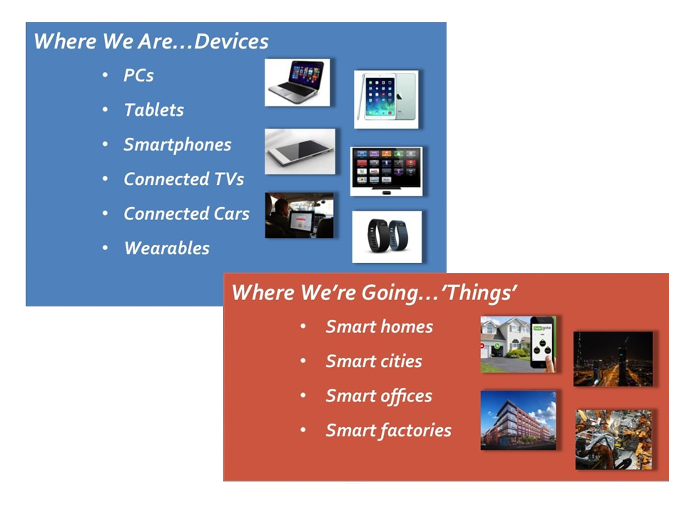
Internet of Everything

Slide 8
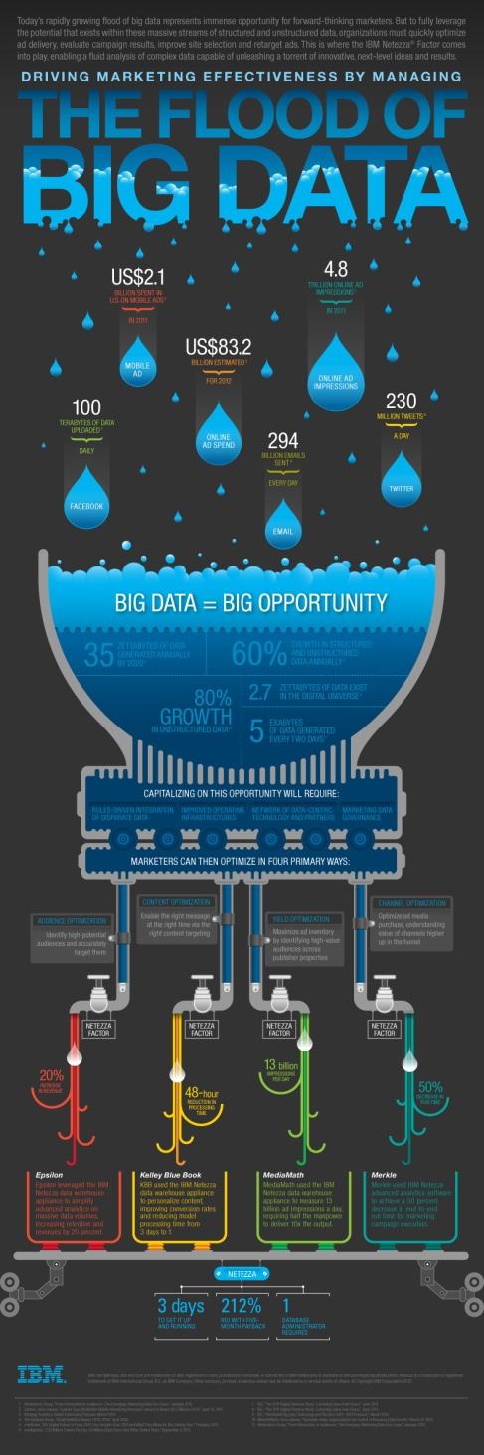
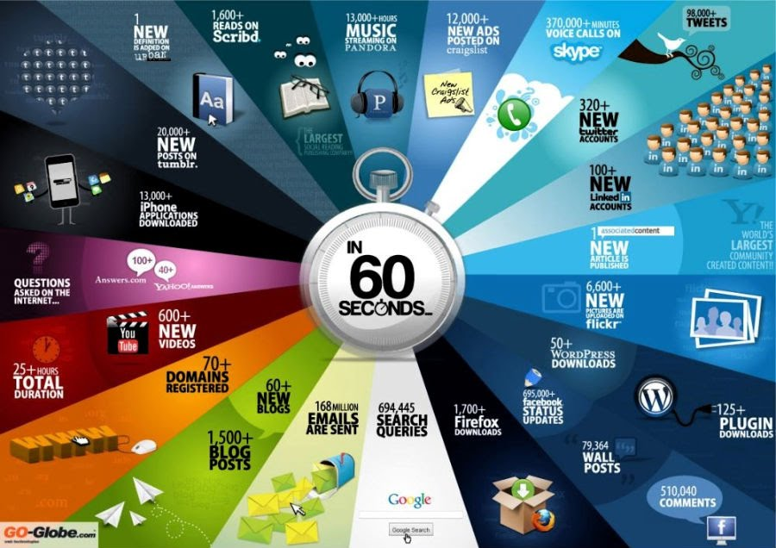
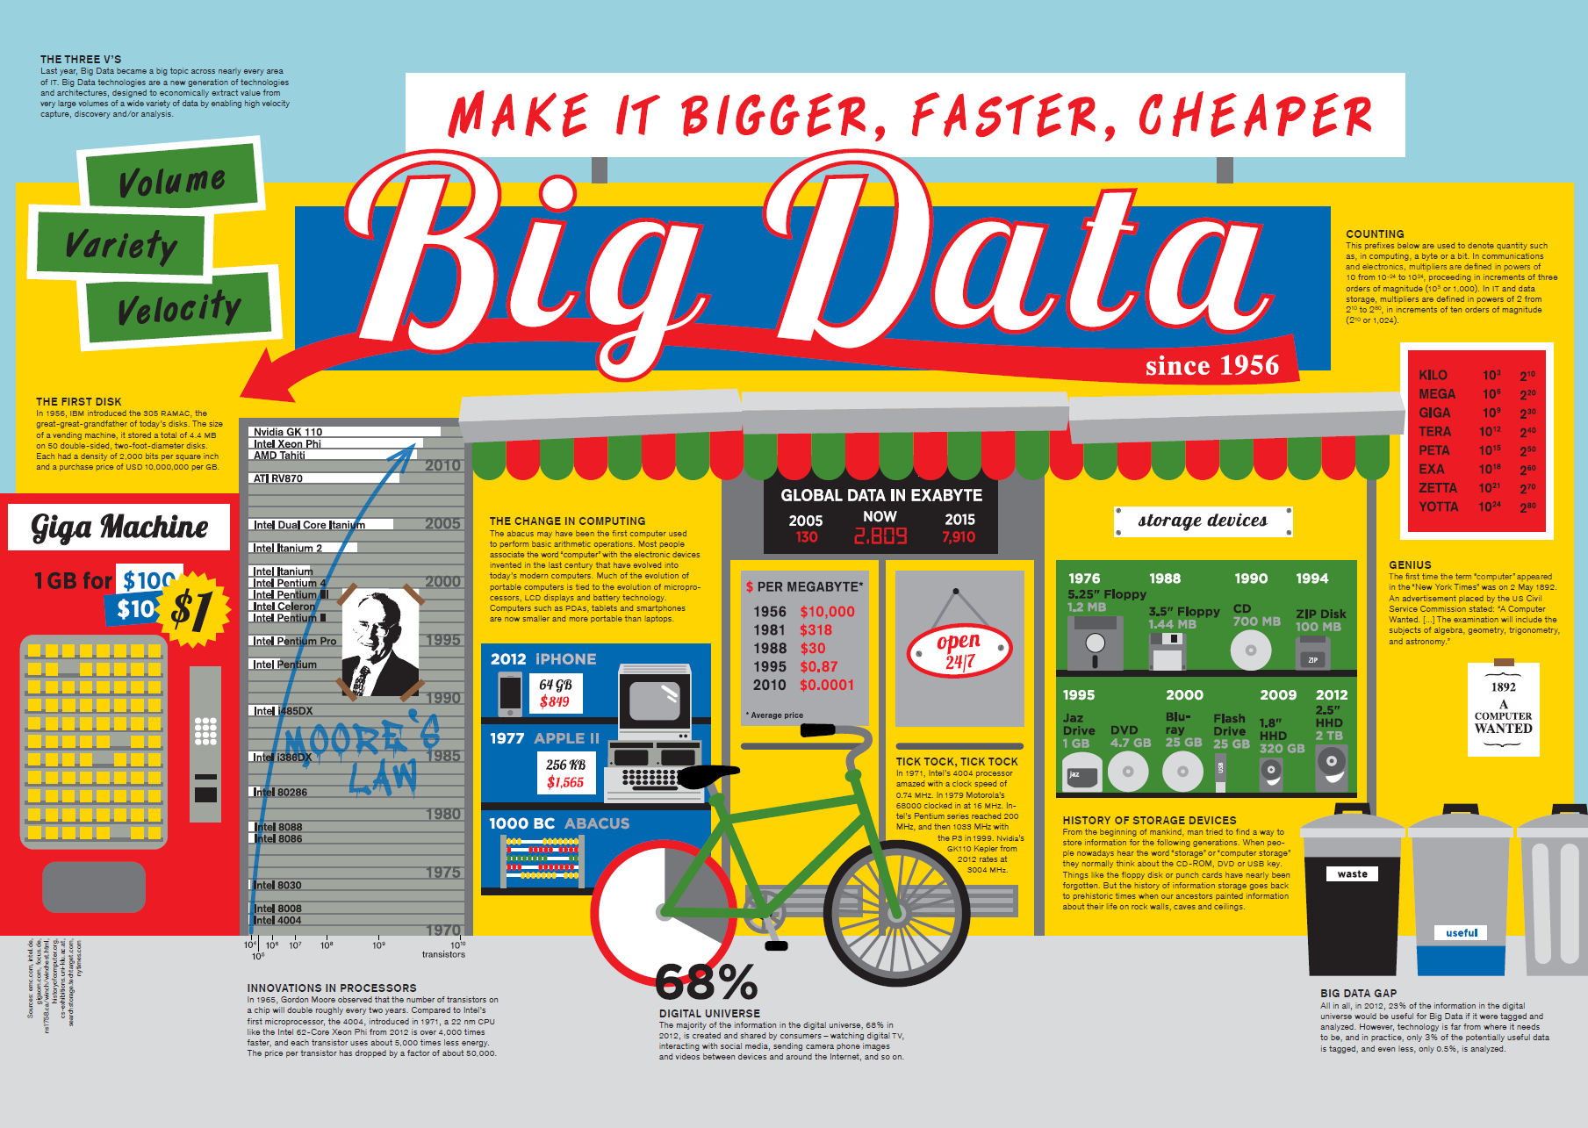
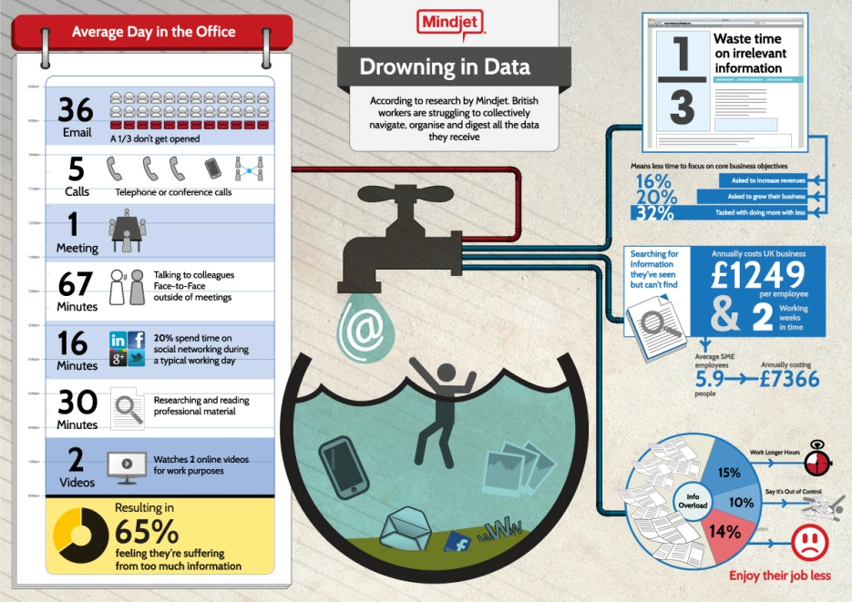
Big Data
Perhaps you’ve seen these before?

Slide 9
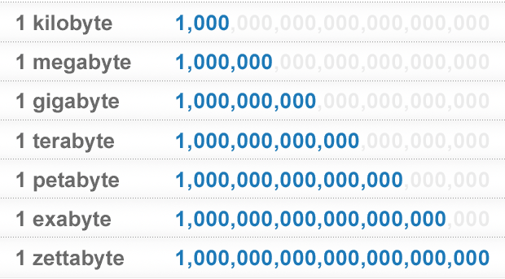
Big Data
So, we know that “big data” is BIG…
But, what does that mean to us?

Slide 10
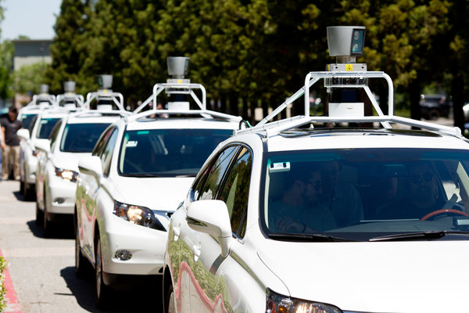
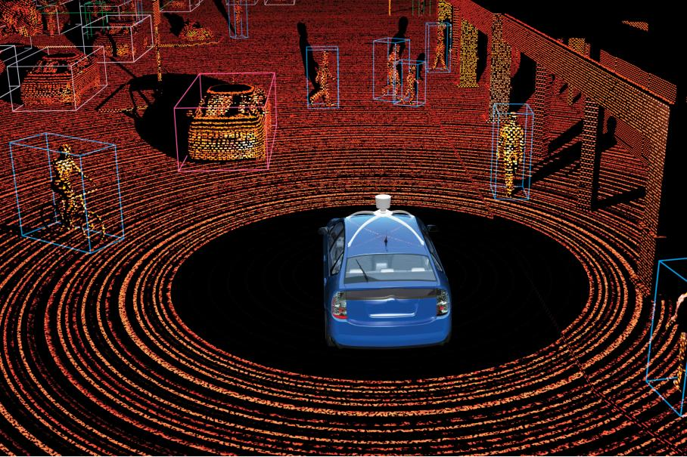
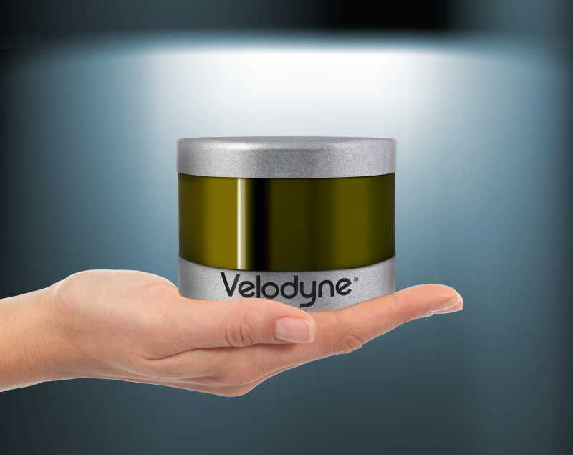
Big Data

Slide 11
Big Data
Every SECOND one of these cars captures:
1.3 million points (rows) of data
or
1 GB data on the hard-drive
For a 20 MINUTE drive, that’s:
1,300,000 x 60/sec x 20/min = 1,560,000,000 rows
or
120,000,000,000,000 (120TB)

Slide 12
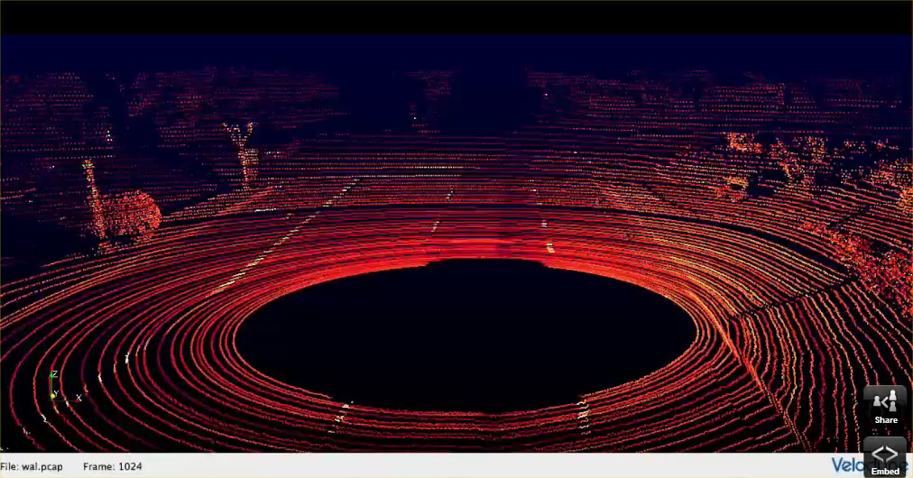
Big Data

Slide 13
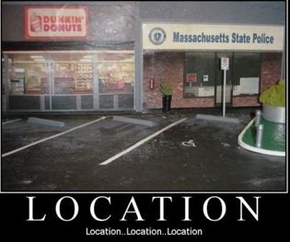
Location
Location Matters…

Slide 14
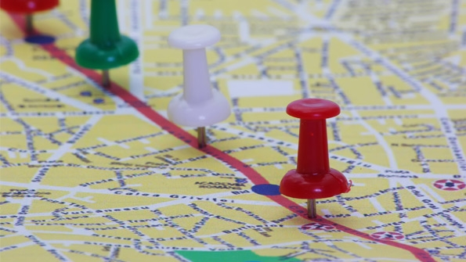
Location
Everything happens somewhere…
and at a specific time…

Slide 15
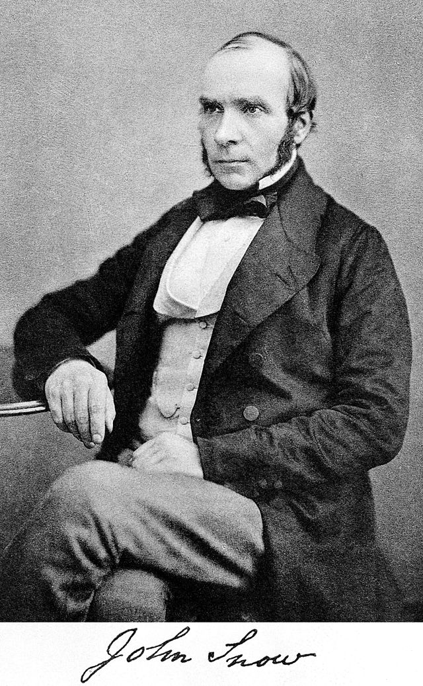
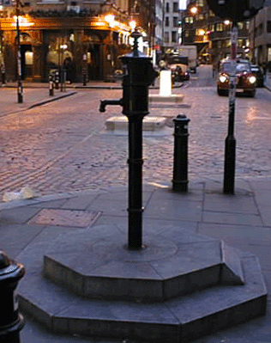
Dr. John Snow
Dr. Snow is frequently referred to as the 'father of public health.' In 1854 a cholera epidemic raged across Europe. The onset of the disease is sudden and death can result in as little as a week. In London, one devastating outbreak claimed the lives of more than 500 people in just ten days. The search for the cure and the cause was furious and fruitless.
Dr. Snow had observed cholera first-hand in 1831 as an apprentice surgeon, but it was only 17 years later, in 1848-1849, that he developed a new theory for the mechanism of cholera transmission. Contrary to the prevailing belief, Snow argued that cholera was a disease of the gut and that the causal agent must enter through the mouth and then multiply within the gut of the sufferer, subsequently spreading to others. Dr. Snow reasoned that broad transmission of cholera had to be due to contaminated drinking water.
In September 1854, when Dr. Snow was called on to examine the causes of the cholera epidemic, he turned immediately to the water supply. His previous research suggested that the localized nature of the outbreak would mean that the cause had to be a contaminated pump or well, rather than a problem with the general water supply. He discovered that while there were five water pumps in the neighborhood, most of the deaths took place near the pump on Broad Street. Upon further investigation he discovered that among the deaths of people situated farther from the Broad Street pump, half of the deceased preferred the water from the Broad Street pump to their nearer pump, and another third attended school near the ill-fated pump. Upon presentation of his findings to community leaders, the handle of the Broad Street pump was removed, and the epidemic quickly abated. Further investigation of the well discovered that a sewer pipe underground was leaking raw sewage into the drinking water of the Broad Street pump.
Dr. Snow realized that a spot map illustrating the location of the deaths in the Broad Street cholera outbreak would be a useful addition to his report. Snow's famous map was first exhibited at a meeting of the Epidemiological Society of London in December 1854.

Slide 16
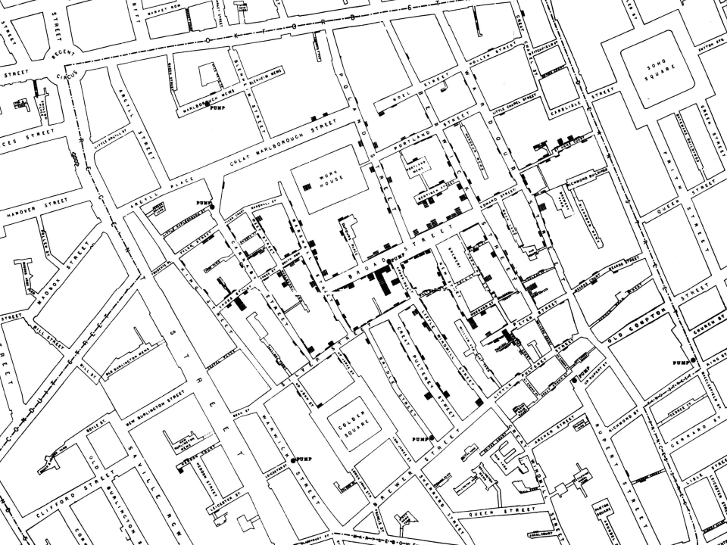
John Snow Map, 1854
Soho, London, England
Regent Street
Piccadilly Circus

Slide 17
John Snow Map, 1854
Soho, London, England

Slide 18
John Snow Map, 1854
Soho, London, England

Slide 19
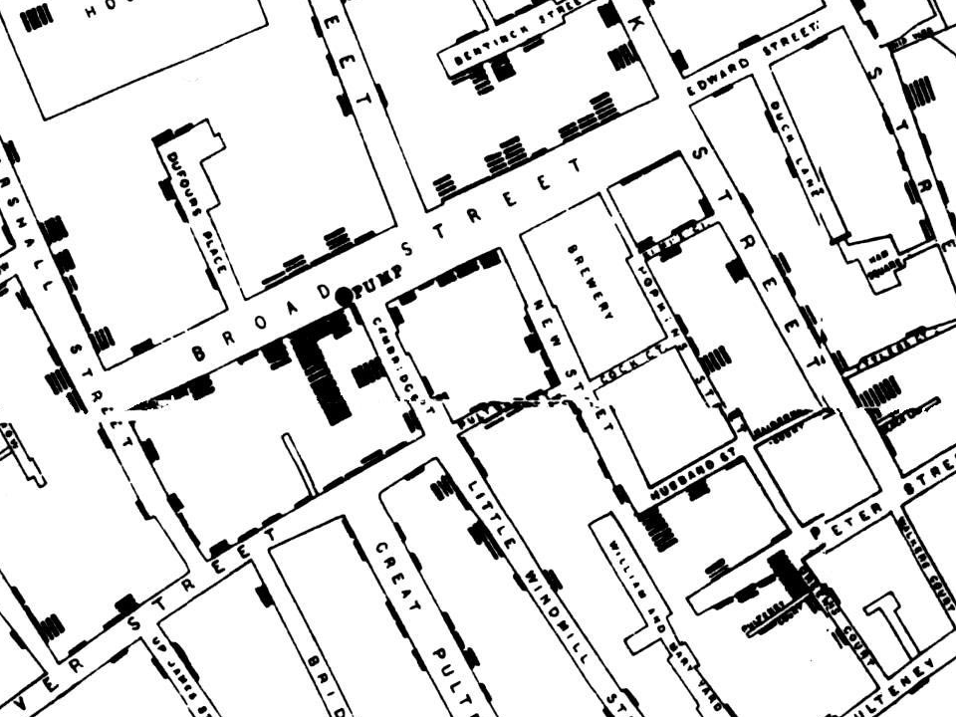
John Snow Map, 1854
Soho, London, England
Water Pump
Location and Number of Deaths

Slide 20
John Snow Map, 1854
Soho, London, England

Slide 21
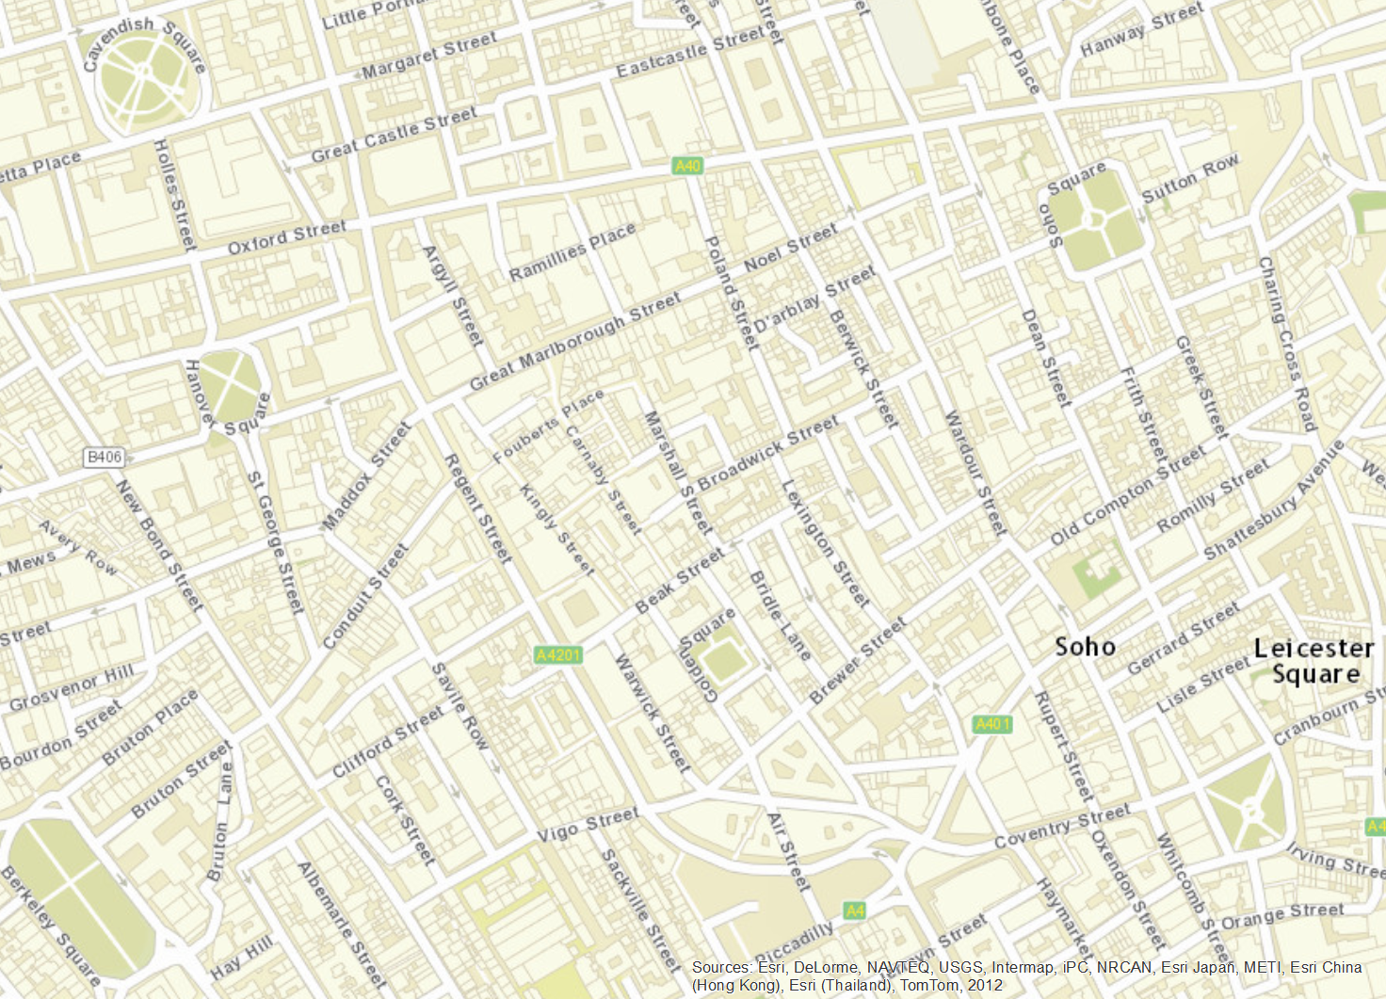
160 Years Later
Soho, London, England

Slide 22
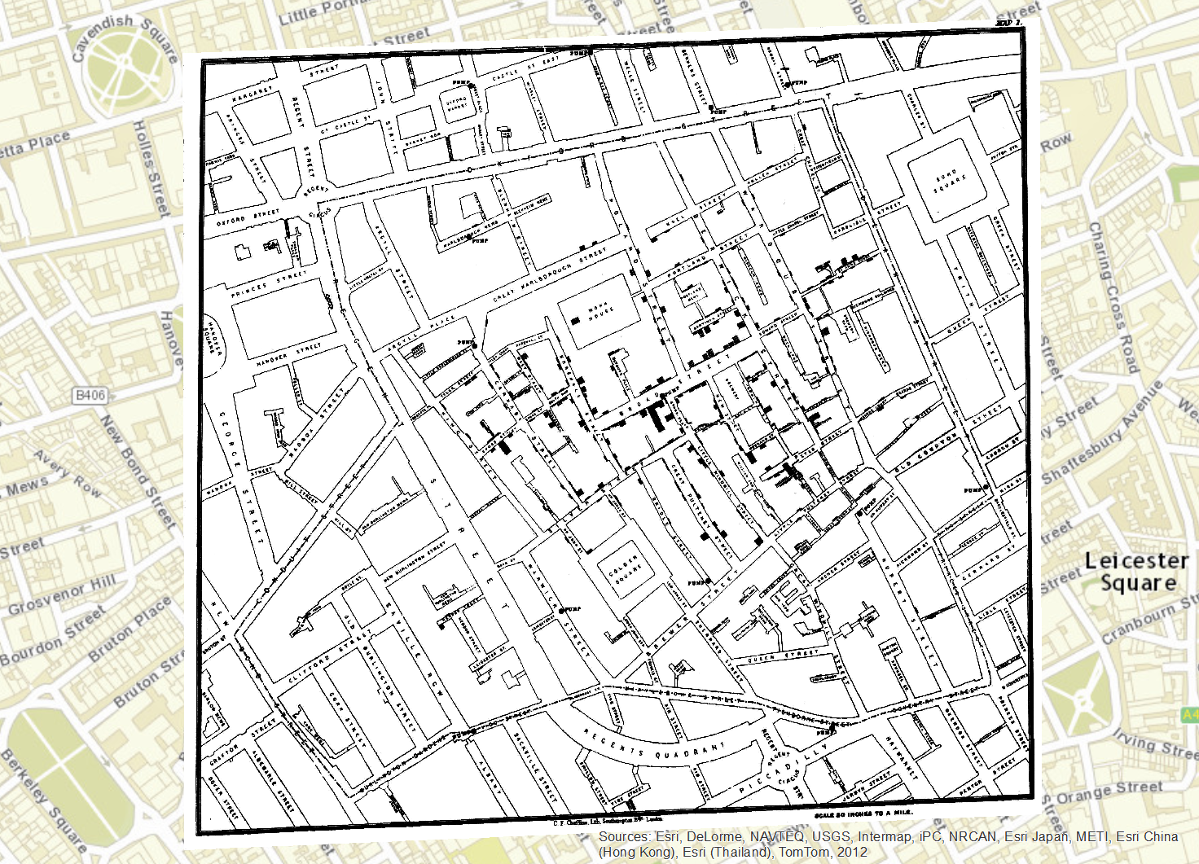
2014 map / 1854 map
Soho, London, England
Georeferenced image of the 1854 map

Slide 23
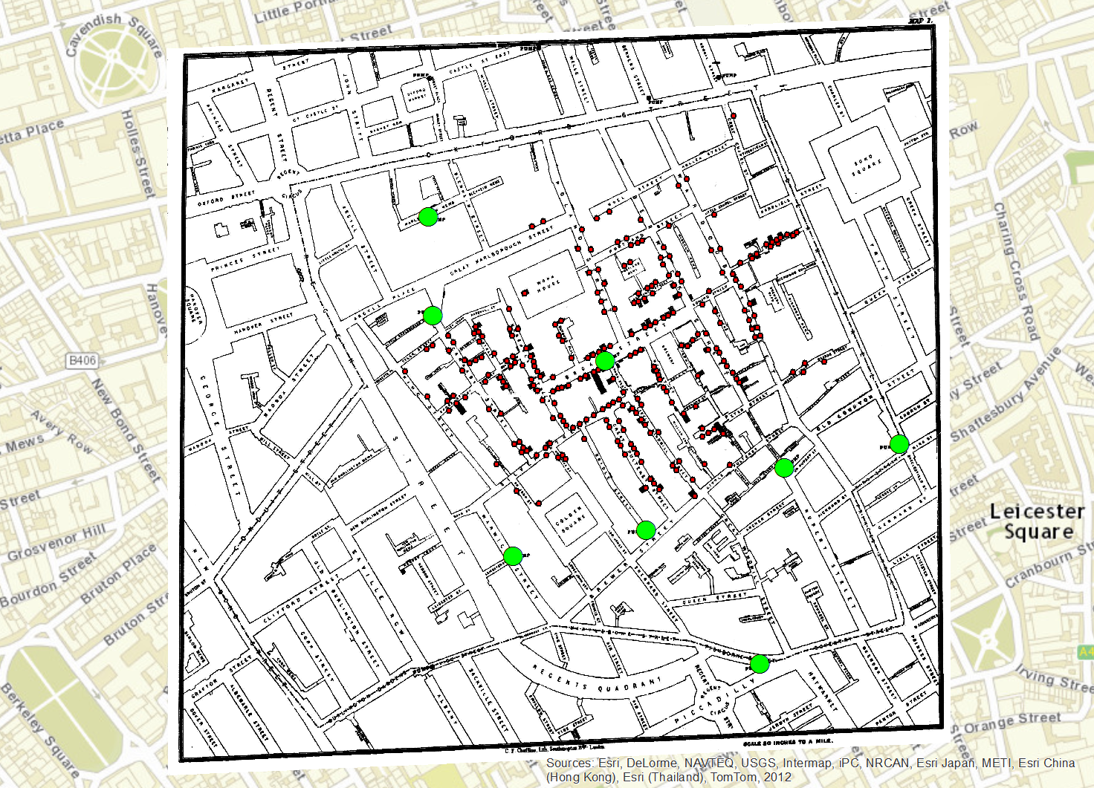
2014 map / 1854 map
Soho, London, England
Locations of water pumps and deaths

Slide 24
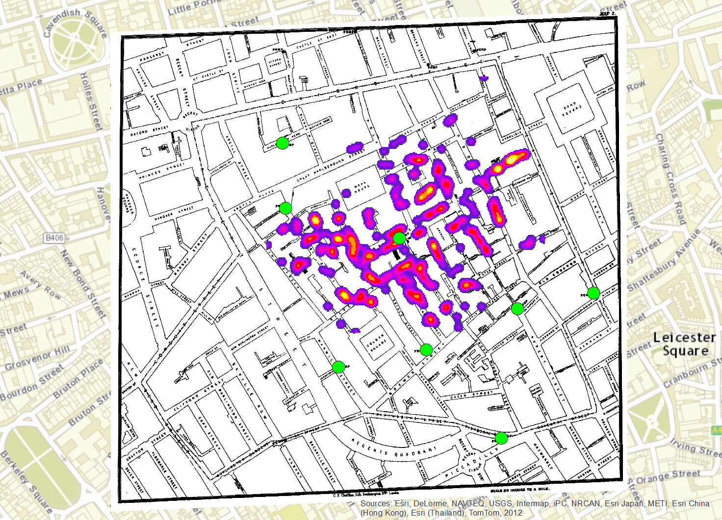
2014 map / 1854 map
Soho, London, England
Density of location of deaths

Slide 25
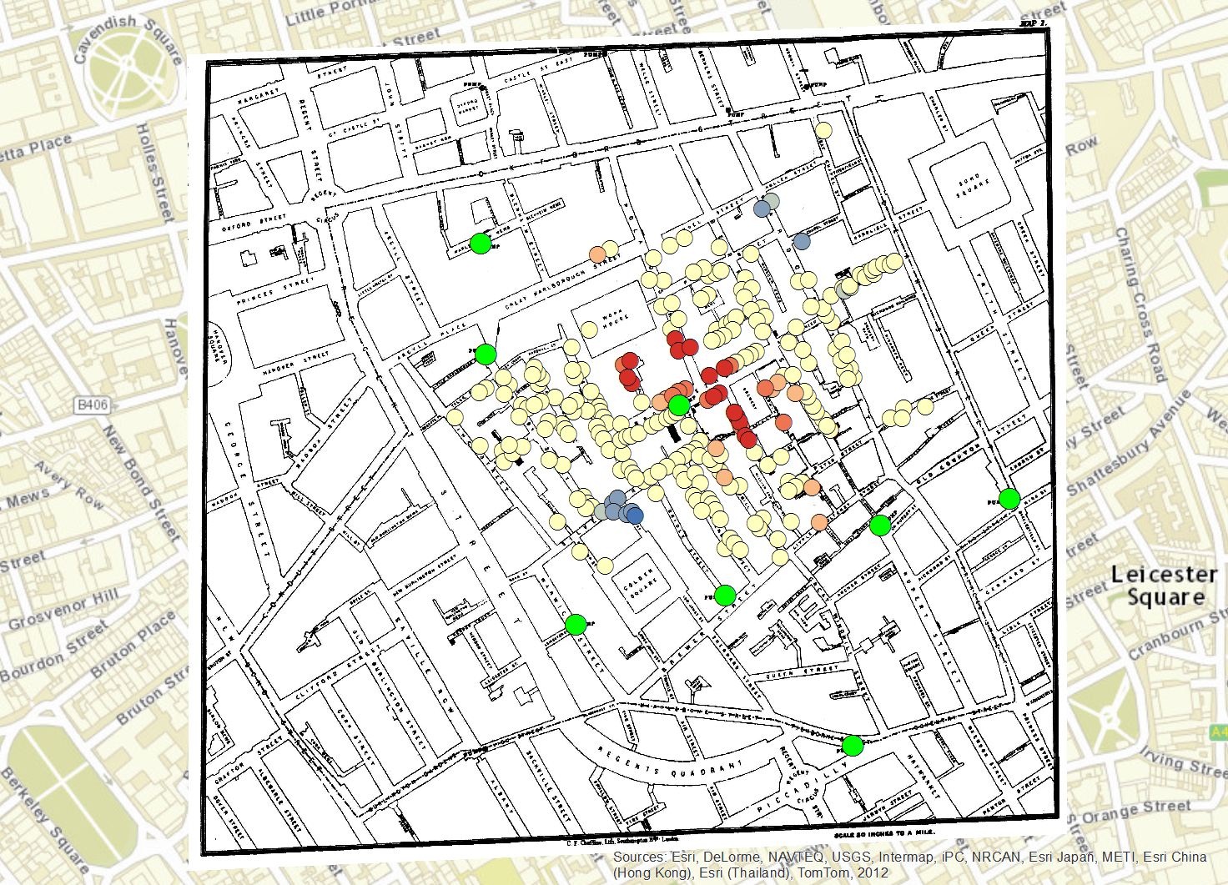
2014 map / 1854 map
Soho, London, England
Broad Street Pump
Statistically significant “hot spots” of deaths

Slide 26
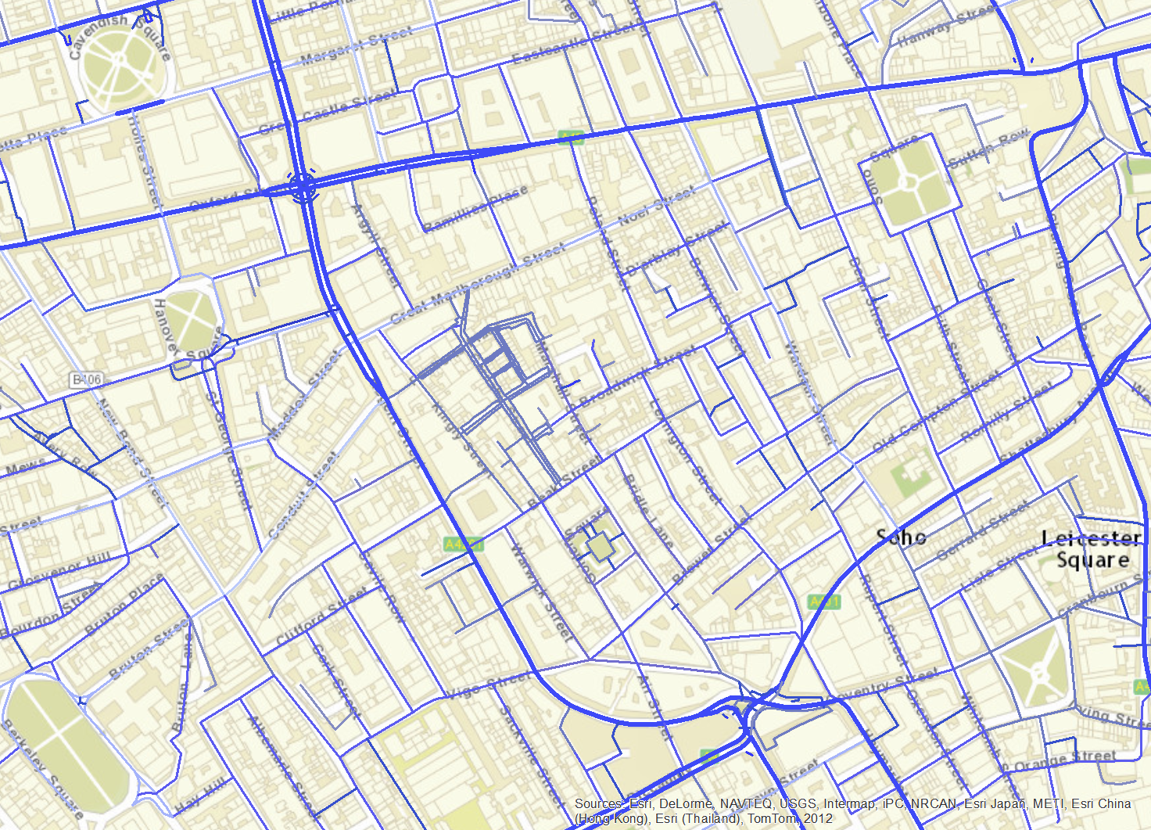
John Snow now…
Soho, London, England
Water mains and branches

Slide 27
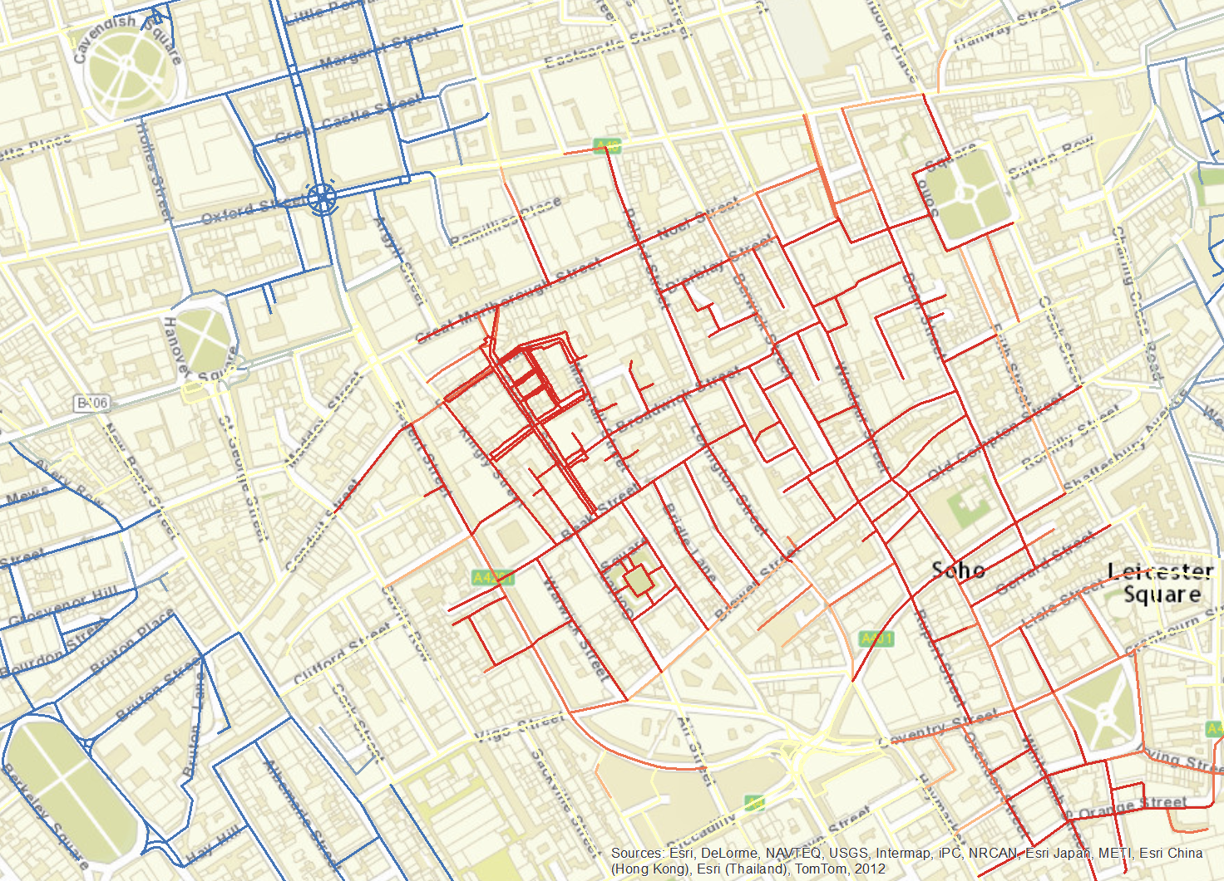
John Snow now…
Soho, London, England
Real-time monitoring to identify problems

Slide 28
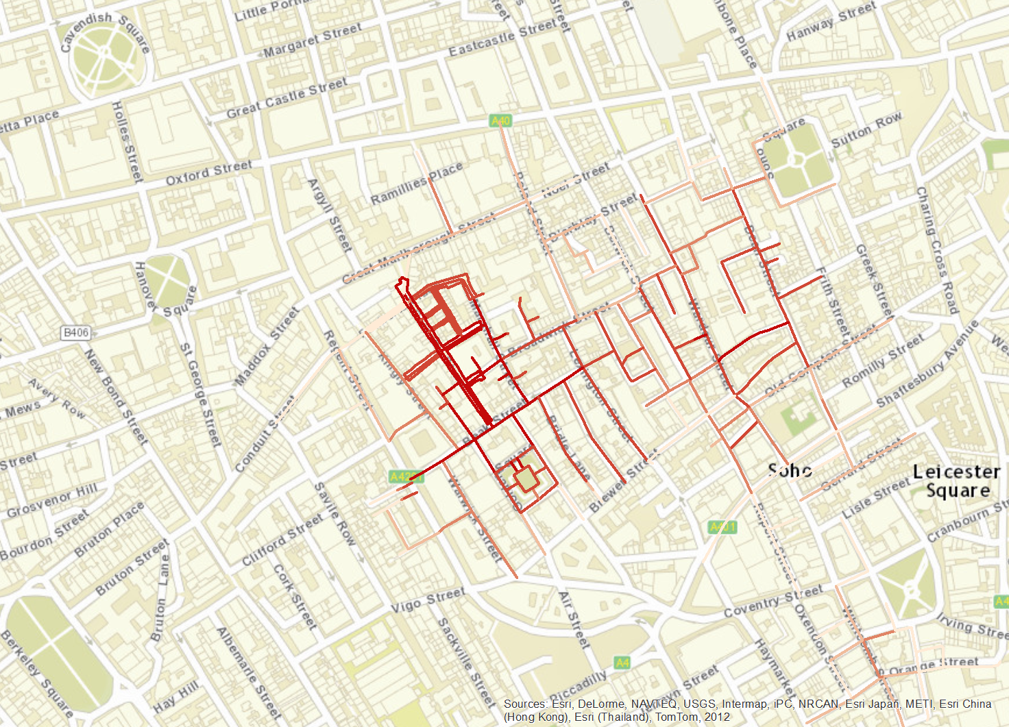
John Snow now…
Soho, London, England
Hot spot analysis and identified water lines

Slide 29
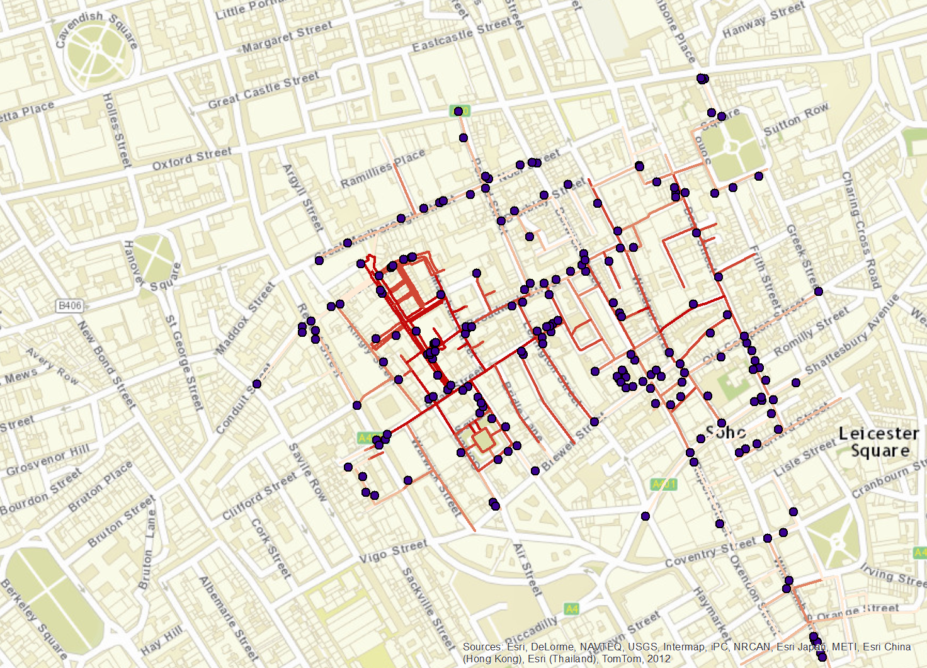
John Snow now…
Soho, London, England
Location of 999 calls and water lines

Slide 30
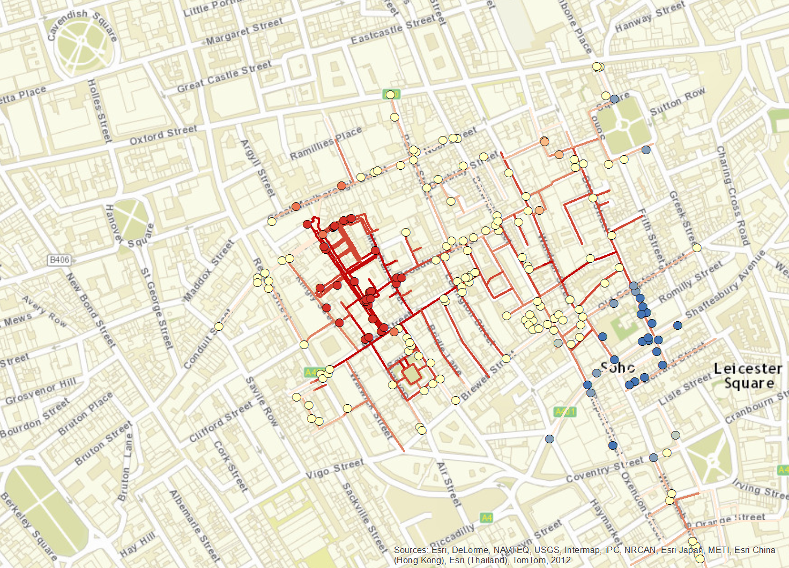
John Snow now…
Soho, London, England
999 “hot spots” related to waterborne illness

Slide 31
John Snow Now…
Previous examples were:
Descriptive – What Happened?
Diagnostic – Why Did It Happen?

Slide 32
John Snow Now…
What about…
Predictive – What Will Happen?
Prescriptive – What Should We Do?

Slide 33
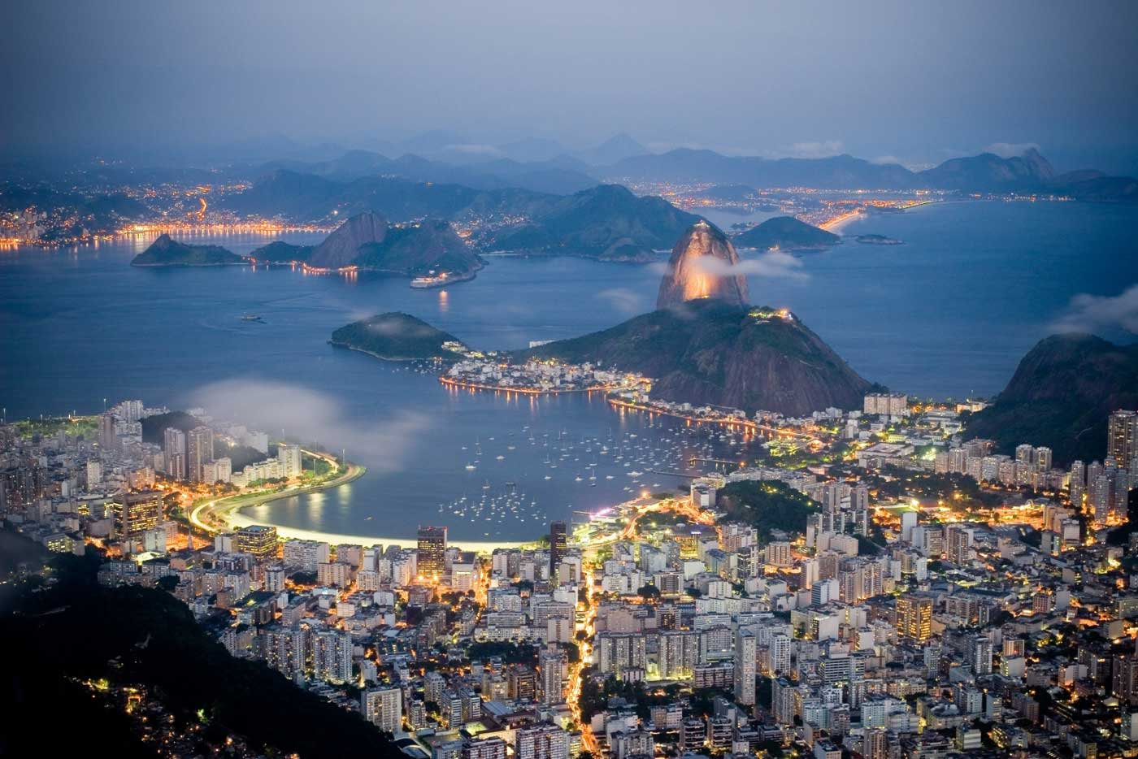
John Snow Now…

Slide 34

John Snow Now…

Slide 35
John Snow Now…
The ability to run multiple simulations, using big data, big data technologies, and sophisticated analysis…
For example,
Global epidemic and mobility modeling combining data on human population, human mobility, and complex, stochastic, models of disease transmission.

Slide 36
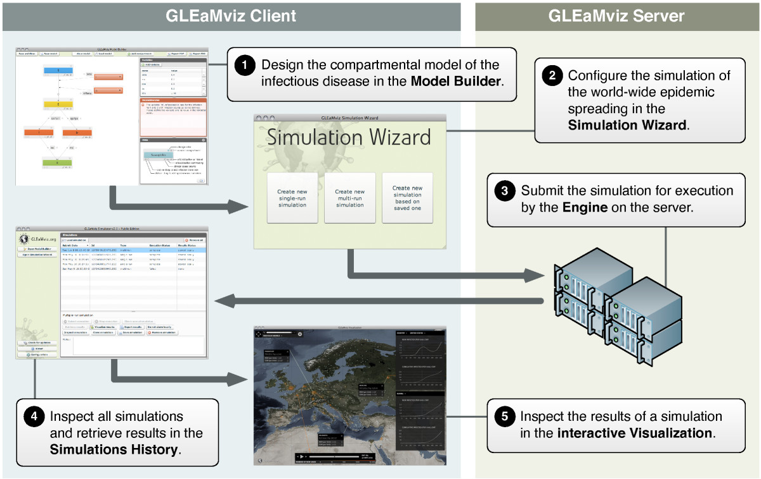
John Snow Now…

Slide 37
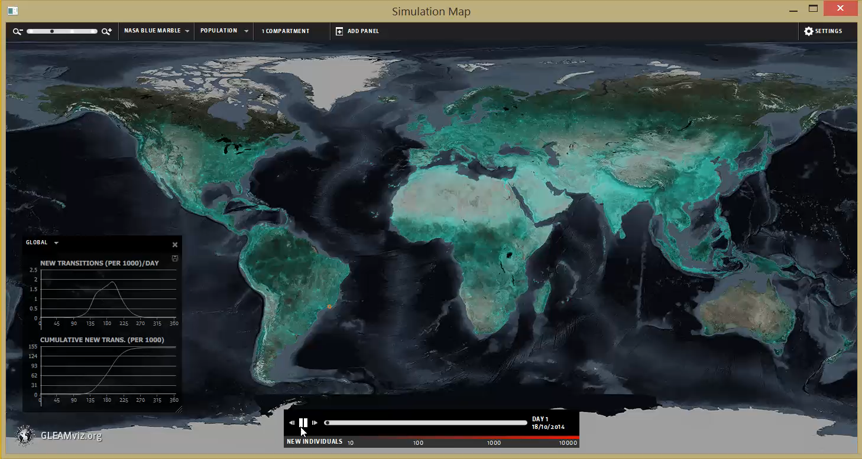
John Snow Now…

Slide 38
Big Data and Analytics
The Details

Slide 39
What (is)?
Analytics
  From art to science of decision making (DM)
  Data driven DM
  Evidence-based DM
In God we trust, everyone else bring data!

Slide 40
Organizational/Business Decision Making
Art?
Science?
Examples
Allocating resources (Service/technician, bank tellers, ..)
Wine quality ratings
eBay auction end times
Overbooking at airlines
Credit card offers (% APR, cash offer, cash back, …)
Choice of advertisements
Picking/packing items at warehouses
Loading/unloading trucks
Displaying items at grocery stores
Cart size at Costco
Loan processing at banks
Notes:
Discuss whether DM is art or science.
Using the examples, discuss what types of decision could be science.
What aspects/parts could be science.
Discuss evolution from art to science.

Slide 41
Examples
Allocating resources (Service/technician, bank tellers, ..)
Wine quality ratings
eBay auction end times
Overbooking at airlines
Credit card offers (% APR, cash offer, cash back, …)
Choice of advertisements
Picking/packing items at warehouses
Loading/unloading trucks
Displaying items at grocery stores
Cart size at Costco
Loan processing at banks
Organizational/Business Decision Making
Art?
Science?
Seat-of-the pant
Expertise
Evidence-based
  Available
  Experimentation
Analysis-based
Decision support
Decision making
Modeling
Static
Dynamic
Mathematical
Statistical
+ Spatial
(including geography)
Techniques
Hypothesis testing
ANOVA
Regression
Cluster analysis
Deterministic
Stochastic
Outcome characteristics (the bottom line)
Efficiency (faster, cheaper, …)
Effectiveness
Notes:
Under at discuss problem solving methods, group problem solving, etc. (Management course material)
Discuss expert systems (we typically discuss in an IS course) for expertise based DM.
Discuss Decision Support Systems (DSS) as part art and part science in DM.
When we move from art to science (for a particular class of decisions) the outcome should be improved efficiency or effectiveness.
Evidence could be something that already exists or something collected (on demand) through experimentation.

Slide 42
What (is)?
Big data
  Small versus Big

Slide 43
What (is)?

Slide 44
What (is)?
Big data
  The five Vs
    Variety
      Source
        Internal/External (Government/Private, free/fee)
        Explicitly collected vs. self-reported
      Type (Numeric, text, picture, audio/video, geographical, ..)
    Velocity
    Volume
    Veracity
    Value

Slide 45
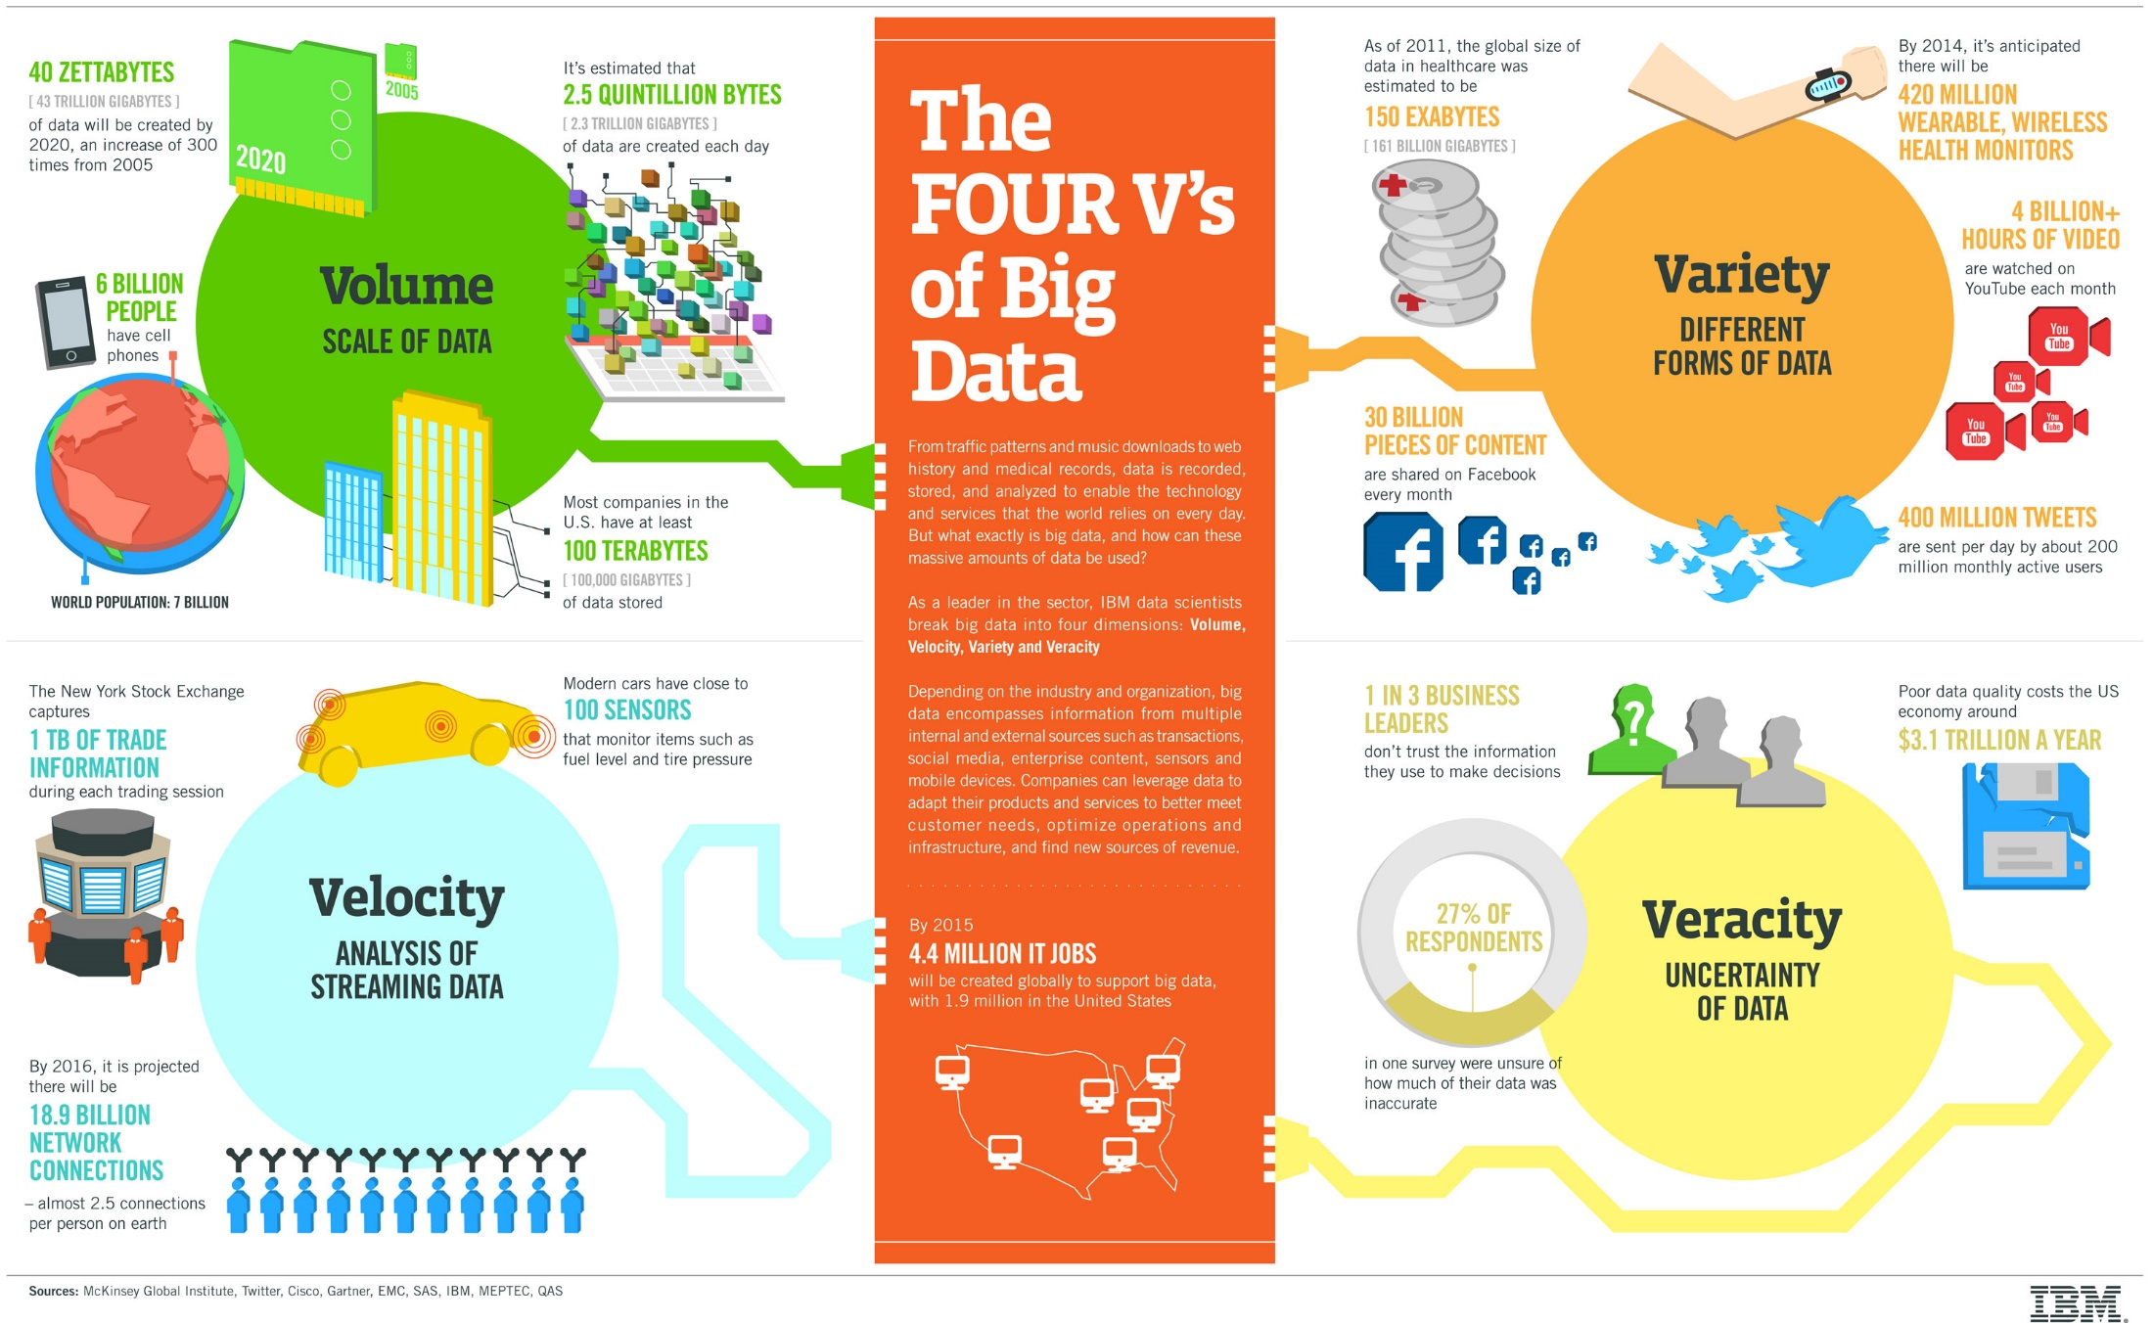
What (is)?

Slide 46
How (did we get here)?
Analytics
From DSS to BI to Analytics
Science of Things/DM
  Management Science (1955)
  Decision Sciences (1969)
  Marketing Science (1981)
  Organization Science (1989)

Slide 47
How (did we get here)?
Big Data
  Storage (cost, availability, sharing, etc.)
  Systems (enterprise-wide, Internet of things, sensors, etc.)
  Practices/processes (social media – user-generated data)
  Where are we with respect to big data?

Slide 48
Why (should be care about big data)?
Support for decision making (improvements in efficiency and/or effectiveness)
Descriptive, diagnostic, predictive, & prescriptive analytics

Slide 49
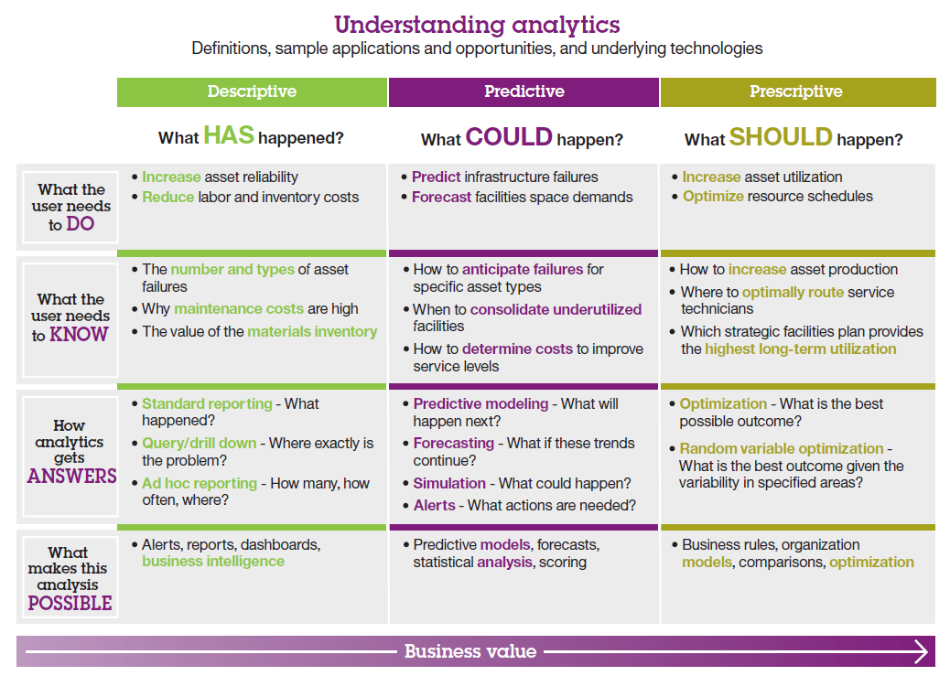
Why (should be care about big data)?

Slide 50
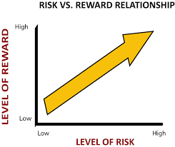
Why (should be care about big data)?
Some examples
  Watson & Marjanovic, 2013 article.
Chart on opportunity/value versus Challenges

Slide 51
Why (should be care about big data)?
Examples of big data opportunities in different industries (Watson & Marjanovic, 2013):
Automobile Insurance | Manufacturing, Distribution, and Retail | Transportation and Logistics | Telecommunications | Utilities | Law Enforcement | Gaming
Insurance pricing Better client risk analysis Fraud detection Faster claims processing | Track shelf Availability Assess the impact of promotional displays Assess the effectiveness of promotional campaigns Inventory management Pricing | Real-time management of truck fleets RFID data for asset tracking | Analysis of patterns of services across social networks Determine profitability of customers’ social networks Churn minimization | Smart-grid data to determine variable pricing models Smart meters to better forecast energy demand Customized rate plans for customers | Identify people linked to known trouble groups Determine the location of individuals and groups | Capture players’ actions to provide comprehensive feedback to game producers Analysis of game plays to determine the best opportunities for in-game offers

Slide 52
What (will the future look like)?
Something to ponder...
  Data is coming from everywhere
  Data comes in all types, sizes, speeds, quality, etc.
  Data is spatial

Slide 53

What (will the future look like)?
What does this mean for you?
Psychology
Public Health
Mathematics
...

Slide 54

What (will the future look like)?
What does this mean for these domains?

Slide 55
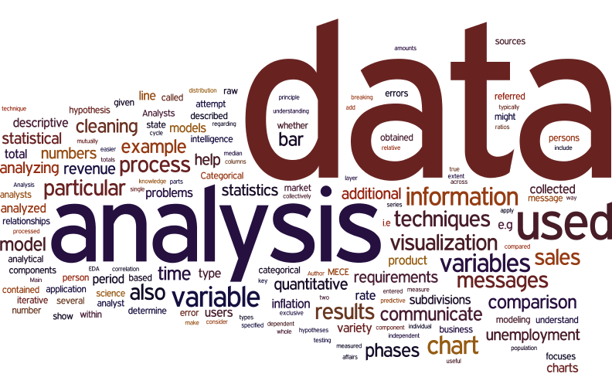
What (will the future look like)?
Are analytics any different for Big Data (as compared to small data)?

