Slide 1
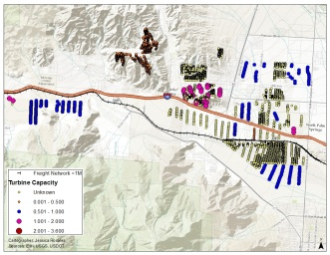
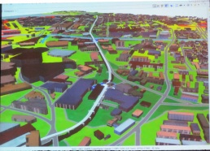
WORKSHOP ON GEOGRAPHIC INFORMATION SYSTEMS
ICIS 2014, Auckland, New Zealand
Presenters
James Pick*, Hindupur Ramakrishna*, and Tom Horan**
*University of Redlands
**Claremont Graduate University
Keynoter
Scott Campbell, Eagle Technology Group Ltd.
Auckland, New Zealand
9am – 2:30pm, Sunday, December 14
Location: Case Room 1, 260-00,
Auckland School of Business

Slide 2
PRE-ICIS WORKSHOP FOR ICIS 2014

Slide 3
GIS Workshop Agenda (cont.)

Slide 4
Workshop Rationale
Because of GIS’s expansion in the business world, this workshop has the goals to explain GIS concepts to IS/MIS academics, justify why it’s an essential part of the IS discipline, and provide a roadmap to develop the area further as individuals, programs, and departments.
Where we are…
GIS, mapping, and geospatial information are rapidly expanding for citizens and consumers in society.
Business schools, public administration and information schools are recognizing GIS as a key concept and tool in information systems and science.
Some IS programs have initiated GIS for curriculum and research.

Slide 5
How the workshop can contribute…
Knowledge vital to IS in business and organizations.
It stresses GIS’s role as part of the IS academic field.
It highlights the geospatial industry and its growing workforce opportunities for employees with business and GIS backgrounds.
It provides examples of use in marketing, utilities, and site analysis.
It describes the current status and great opportunity for GIS research in IS/MIS field.
It includes a panel of two refereed research papers
It gives resources, examples, contacts, and networking, to get started or advance further.

Slide 6
GIS Workshop - Outcomes
The workshop expectation is to appreciate as well as learn.
Those attending who already are expert or moderately informed can consolidate ideas, engage in discussions and contribute ideas and experiences.
Appreciate how knowledge and skills in the geospatial field can inform IS teaching and research.
Getting started in this field is not difficult. Can be worked in smaller steps into scholarship and teaching without huge technical support and without large dollar outlay.
As the workshop conclusion, suggestions will be given on what your next steps could be.
  One is that AIS has SIGGIS.
All materials from the workshop are available digitally at
  http://www.redlands.edu/academics/school-of-business/11264.aspx#.VIE_M73Tlkg (look in left column)

Slide 7
Workshop packet
Contains:
Agenda of Workshop, with break times
Hardcopy of PowerPoint slides (also available electronically at SIGGIS and GISAB* websites)
  http://siggis.wikispaces.com/home
  http://www.redlands.edu/academics/school-of-business/11264.aspx#.VIE_M73Tlkg
  (click on GIS for GIS Pre-ICIS Workshop button on left part of screen)
SIGGIS information and how to join this SIG.
Workshop Evaluation form
  *Center for Business GIS and Spatial Analysis, University of Redlands
Acknowledgments and thanks:
Staff of University of Redlands School of Business and

Slide 8
Segment 1
Overview of GIS Concepts, Methods, and Architecture.
Why is GIS Important.
Connection to MIS Concepts.
James Pick*, University of Redlands
*note: Dan Farkas, Pace University collaborated in preparing these slides

Slide 9
What is GIS?
A GIS consists of the following elements:
Data-base of attributes
Spatial information
Some way to link the two
Software
Processes
Network or cloud

Slide 10
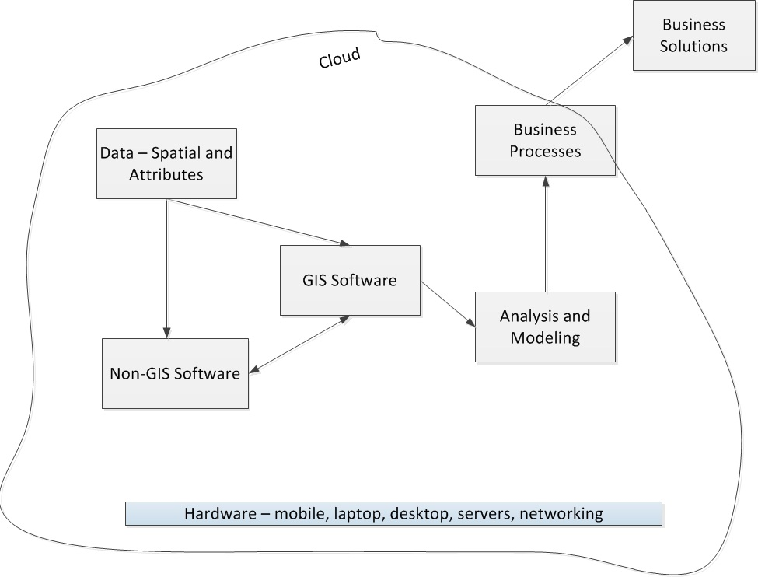
Design elements of a GIS

Slide 11
GIS – Its Place in MIS and the Edge
GIS/spatial is somewhat unrecognized in MIS field.
  Workshop is a step towards bringing it more into MIS.
If you develop GIS/spatial as an interest, it has interactions with other business disciplines, notably marketing, transportation, decision science.
It will encourage interactions in the business school (or information school).
Overarching theme throughout all talks is the advantage GIS/spatial brings to MIS and business research and teaching – the “spatial edge.”

Slide 12
Why is GIS Important?
Economic size and importance
  The geo-services industry revenue in the US in 2013 is estimated at $232 billion (Oxera, 2013).
  If spillover is considered to other sectors, the geo-spatial component of the U.S. economy is estimated at $1.6 trillion (Boston Consulting Group, 2012)
Wide industry breadth and worldwide importance
  GIS and spatial analysis are used heavily in many business sectors including marketing, retail, defense, utilities, logistics, real estate, banking, environment, natural resources, agriculture.
  GIS permeates the developed world and is spreading rapidly in China, Malaysia, Mexico, and other developing nations.
Research Importance
  GIS is a standard research method in earth & environmental sciences in widespread use in econometrics and quantitative sociology.
  IS/IT researchers can benefit by cutting-edge studies and methods.

Slide 13
GIS and Web
Web-based consumer mapping software is prevalent, such as Google Maps/Earth and Yahoo Maps. However, it so far has functioned predominantly for viewing, and does not have the analytics and geospatial features of full-fledged GIS software.
There is underway a significant shift in analytical GIS software from the desktop/server environment to the web/cloud one.
The shift’s advantages are similar to that for IT in the web/cloud:
  Pervasive access Apps widely available
  Openness (if desired) Ease of use
  Metered costing Scalability
  Lowered server and data-base maintenance Variety of data types; easier
  Integration of apps easier Organizations, people integrated
  better

Slide 14
Example of Web GIS: Esri’s Living Atlas
The concept is to move from the static atlas concept to a contributed set of interactive maps and accompanying applications that is centralized and virtual, with real-time feeds from worldwide sources.
Esri staff, Esri user community will build hundreds of 1,000s of content layers. Available to view by public.
Analogy with Flickr or Wikipedia– people can share maps and associate information through it.
Commenced in spring of 2013. So far there are sample sets of layers for imagery, people, earth, and life.

Slide 15
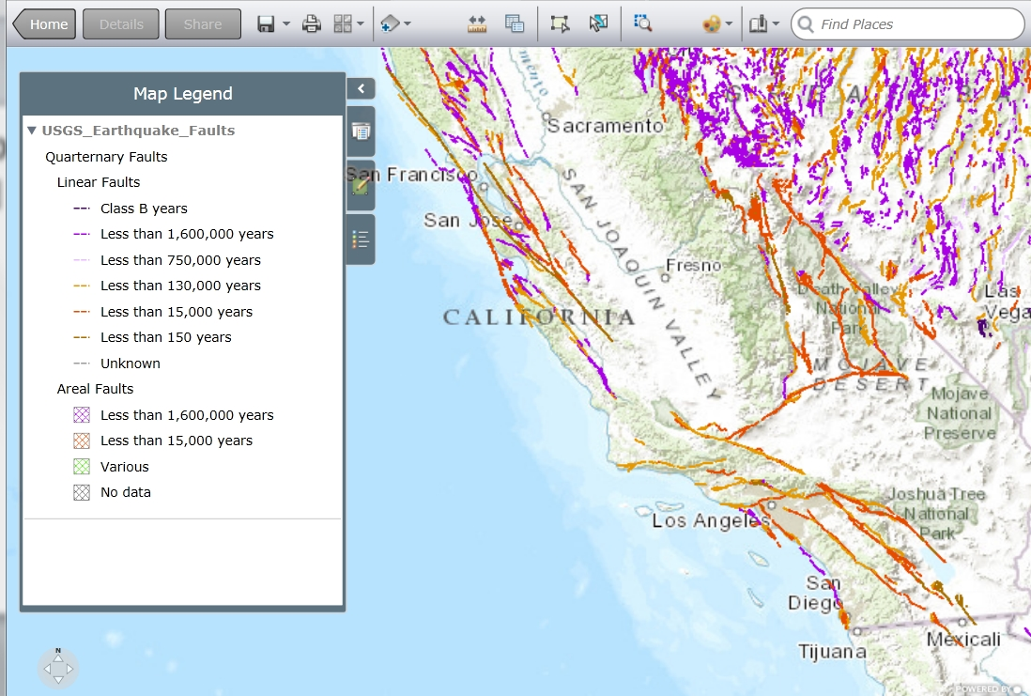
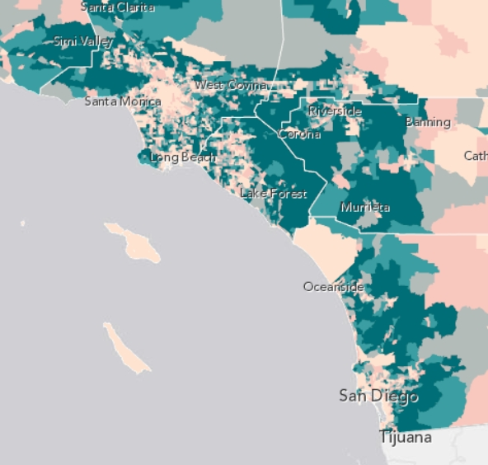
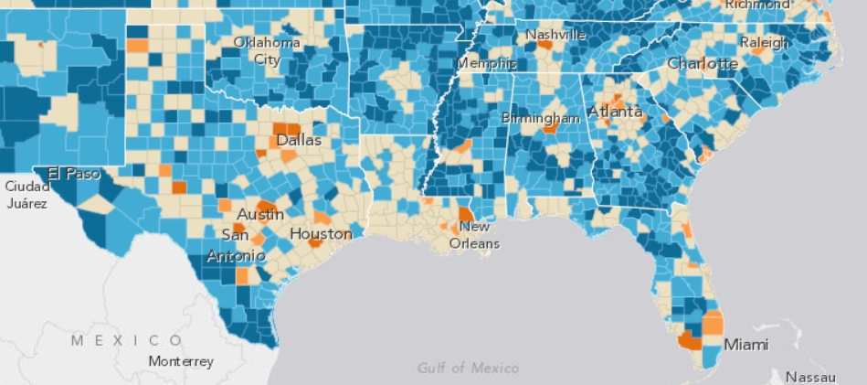
Living Atlas – examples of live contributed maps
These maps are updated in real time, are interactive, and are publicly available.
Housing with Mortgages
(Source: Atlas Publisher)
Quaternary Earthquake Faults by Age
(Source: Esri, Federal User Community, 2013)
Electricity Rates in South of USA (Source: Atlas Publisher)

Slide 16
GIS for Mobile Devices
Mobile devices are utilized by field staff for operations and decision-making. Utility field technicians can check network assets in the field, enter information, and have decision support.
Mobile devices are increasingly geo-enabled, so marketing information can be gathered from location and associated information from customers and the general public.
Consumers can use mobile devices with GPS for a wide variety of business and lifestyle activities, ranging from determining competitors’ locations to car navigation to knowing where social media friends are located to interact.
Example: Geo-enabling of the Field Sales Team for Telecom New Zealand.
  There are about a dozen telecom firms competing for customers in NZ.
  Telecom NZ combined its customer data, digital maps of streets and homes, and its data on door-to-door prospecting of customers to provide sales force with mobile devices showing street and door-to-door information.
  The big data coming to the mobile device created greater efficiencies and higher yield on targeting retention and gaining new customers.

Slide 17
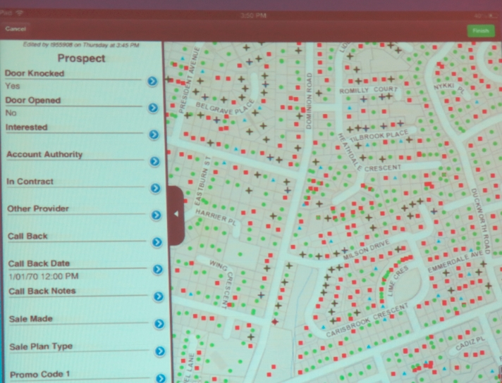
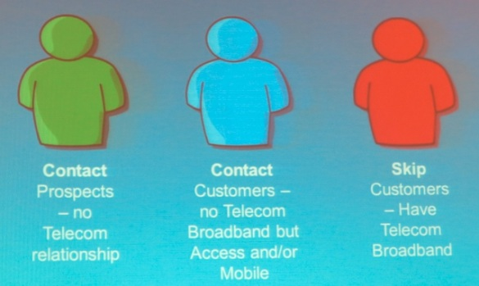
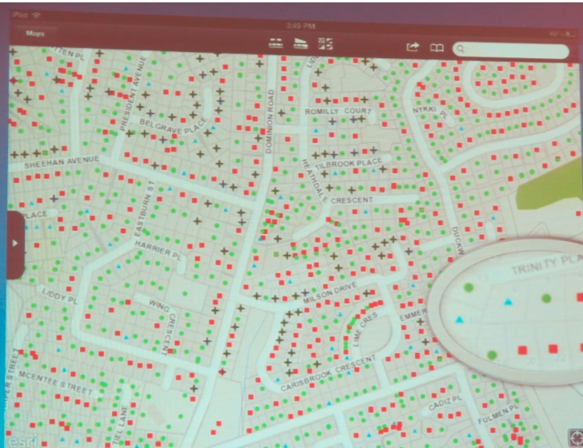
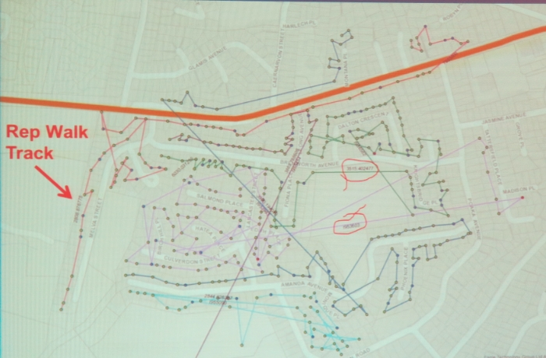
Mobile Geospatial Advantages in field for Telecom New Zealand
3 customer types
iPad display for sales person in field.
iPad display of prospect info.
Spatial analytics walk paths of field reps
(Source: Telecom New Zealand, 2013)

Slide 18
GIS and Big Data
The GIS difference is that the dashboard can show not only graphs/tables, but also maps of exceptions, trends, summaries.
A case example is Union Power Cooperative in North Carolina, which designed a big data application for advanced metering infrastructure.
  Big Data organized in SQL with multiple views
  SQL records are updated in real-time with ArcGIS software database using specialized tools.
  Dashboard written in .HTML to access summary information such as outages, interruptions, meter problems, reliability, and trending.
  (Source: Transmission and Distribution World, 2012)

Slide 19
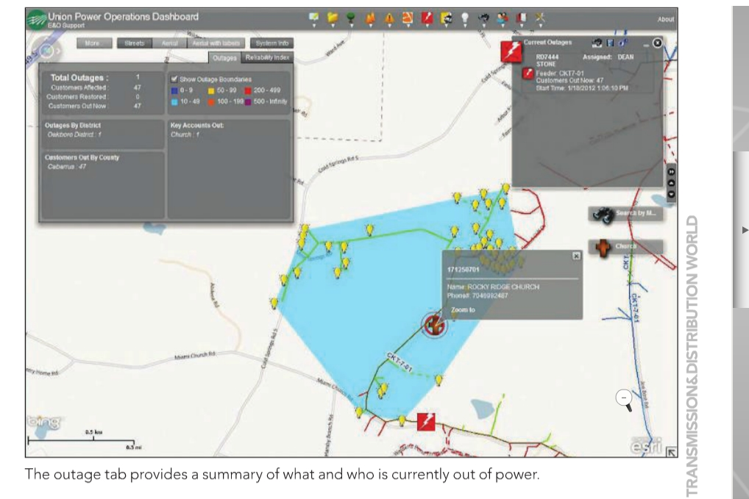
Big Data Mapping at
Union Power Cooperative
(Source: Transmission and Distribution World, 2012)

Slide 20
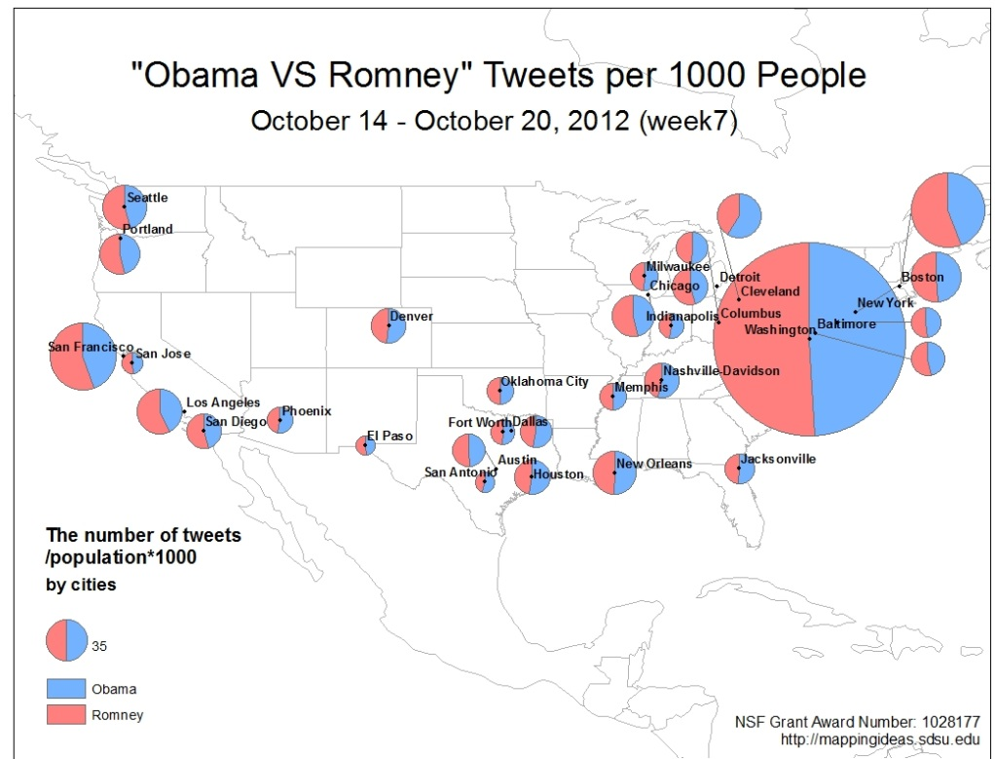
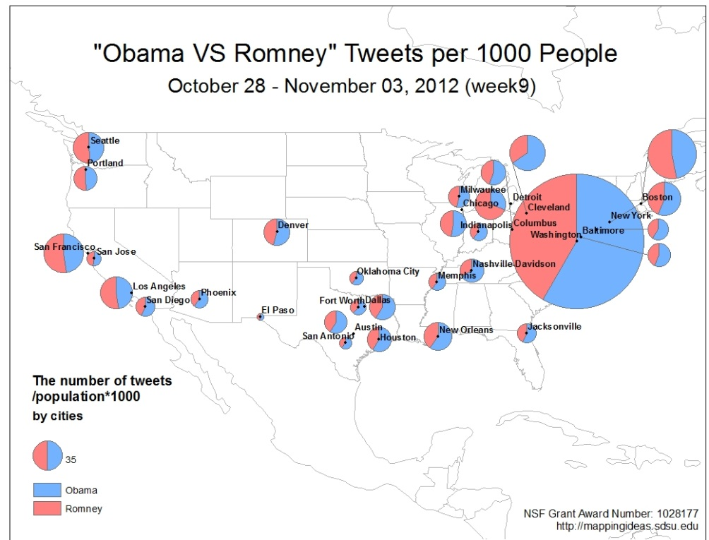
GIS and
Social Media
Example of GIS and social media is a live feed of number of tweets with “Obama” keyword and tweets with “Romney” keyword for largest 30 U.S. cities from Oct. 14-Nov 3, 2012.
The maps from Prof. Ming-Hsiang Tsou of San Diego State show the period before Hurricane Sandy hit East Coast (it hit on Oct. 29, and during the storm (it ended on Nov. 5).
There is a major shift towards Obama during this two week interval, which is more prominent in the northeast.
Most tweets originate with mobile devices. Errors include re-tweeting, robot tweets, city definitions, and positive or negative emotion of the tweet.
The mapping side of social media research is only just beginning.
(Source: M.-H. Tsou, SDSU, 2013)

Slide 21
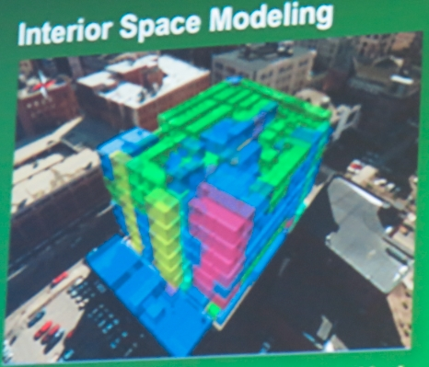
Geo-Design
In geospatial field, an equivalent thrust to engineering’s design science is geo-design.
It views GIS as a method to “devise courses of action aimed at changing existing situations into preferred ones.” (partial quote from Herbert Simon, in C. Stenitz, A Framework for Geodesign, Esri Press, 2012).
Geodesign is done by a team of users at the location, and professionals in IS/IT, design and geographic sciences.
The key design analysis questions are what is current design, what are alternatives for study area to be modified, what are impacts of the changes, what changes should be made?
Geodesign is done on scale from local to global.
Formally, geodesign models are applied to spatial representations, with requirements shifting in an interactive process.
GIS software is incorporated some of the tools.
Source: Esri, 2013
(Source: Steinitz, 2012)

Slide 22
GIS Industry
The size of the GIS software industry is over $5 billion.
It is growing by 10 or 11 percent a year.
When all components (software, hardware, data, services) are taken into account, the size of the GIS/spatial industry is over $50 billion.
Leading companies include Esri, Intergraph, Pitney Bowes Software - MapInfo), Google, Oracle, and Microsoft). Tom Tom and Navteq provide exact base maps of earth, roads, traffic, and other features.
Apple in 2012 tried to get into mapping, but stumbled badly and returned to Google maps.
Post-note: In 2013 Apple purchased GPS firm WifiSLAM.

Slide 23
GIS Data
In the U.S., the GIS industry received the “gift” of massive government spatial data. The data comes from such agencies as the U.S. Geological Service, U.S. Census Bureau, intelligence agencies (restricted), meteorological services, NASA.
Businesses have proprietary data.
Business spatial data providers.
  There are over twenty of them.
  Dunn and Bradstreet
  Nielsen site reports (formerly Claritas)
  GDi (Eastern Europe)
Business Analyst online and desktop
  Has huge geospatial business data-sets for U.S. and recently Canada. Will add 82 nations late this year.

Slide 24
Impact of GIS on Organizations
GIS changes job roles, alters teamwork, shifts cross-functional information exchange, and changes hierarchies.
Companies that were map-intensive formerly had map rooms with skilled personnel to produce, print, store, and revise maps.
As modern GIS becomes pervasive, the vast preponderance of these functions are done electronically, and those remaining are done by the end users.
Other impacts??

Slide 25
GIS Impacts Human and Managerial Actions
GIS alters human and managerial thinking and actions…
Measure
Compare
Analyze
Predict
Decide
Evaluate
Operate
Manage
Act
Evaluate
Consider Ethical aspects
25

Slide 26
Strategy now Spatial at C-level, and senior executive level
Ceo, Cio level.
  As GIS enables a firm’s products, and services, it becomes a strategic element for the company, i.e. at the senior executive level.
  Principles of ceo/cio level MIS strategies can be modified and applied for GIS strategies.
  Examples are:
    Gap Inc. (GIS is corporate competitive feature for international real estate)
    Starbucks (GIS strategies are at C-level for location analytics)

Slide 27
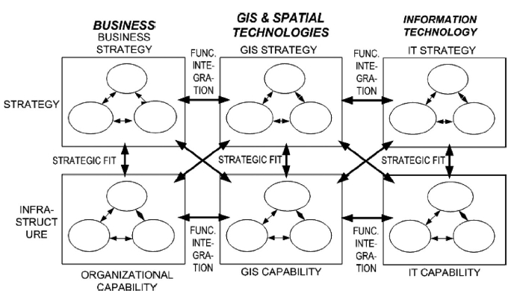
Business-GIS-IT Strategic Alignment Model
(Modified from Papp, 2001)

Slide 28
Spatial Analysis and Spatial Statistics:
Discovering trends and patterns
James Pick, University of Redlands*
* Dan Farkas, Pace University, collaborated in preparing these slides

Slide 29
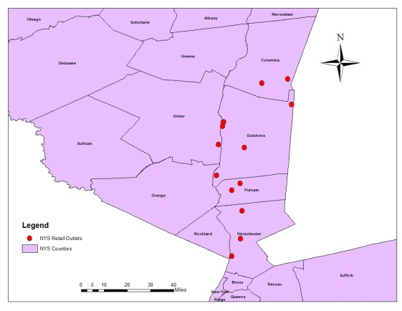
Spatial Analysis is more than looking at a map
Show Trends and Patterns
Select features
Show relationships between features and layers
Perform proximity analysis

Slide 30
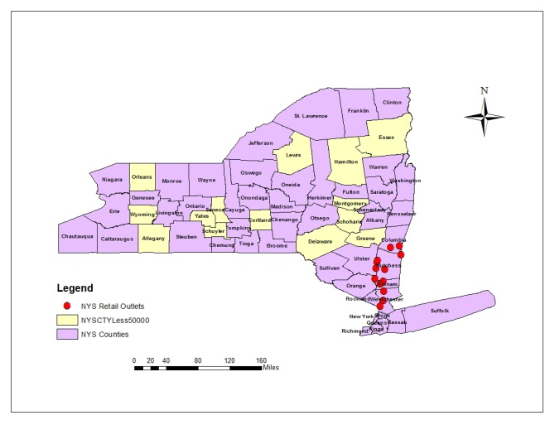
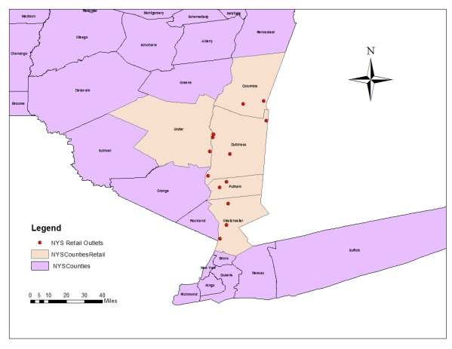
Select Features
By Attribute:
  Use values and selection criteria to highlight features
By Location:
  Use topographical relationships (e.g. contained in) to identify features

Slide 31
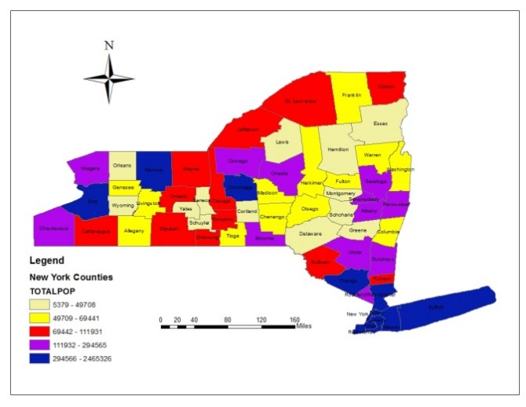
Thematic maps
Use attribute value ranges to determine categories features
Establish the number of classes
Establish how the distribution in to classes is made (e.g., quantile – equal number in each range)

Slide 32
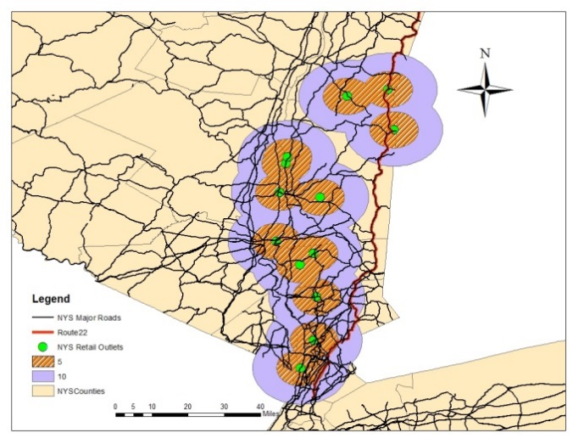
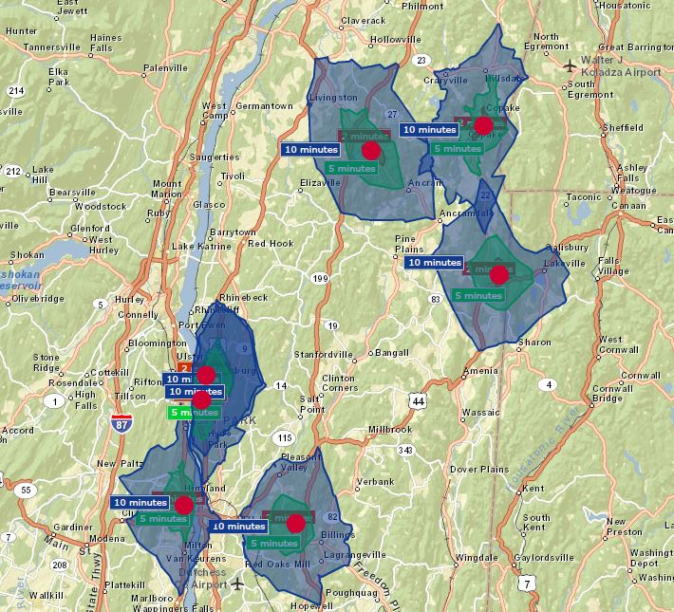
Buffers and Drive-time Analysis
Buffers
  Show, based on distance areas around features. Good to visualize proximity.
Drive-time
  Based on driving conditions and road, establish buffers around features.

Slide 33
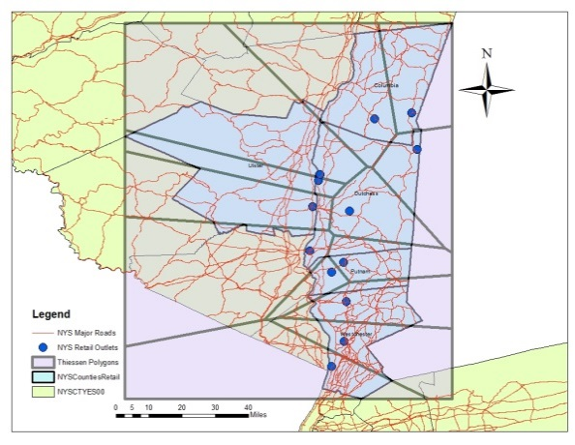
Establishing Proximity Zones:
Thiessen Polygons
identify areas of shortest distance in point layers
each point has the property that all locations within the polygon are closest that polygon’s center
In this example, with an address layer, can be used to identify customer proximity to individual stores.

Slide 34
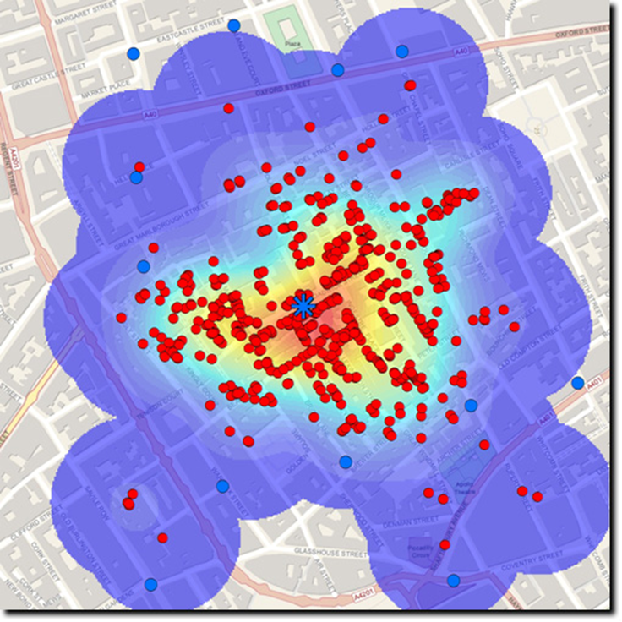

Density
Calculate a density value for geographic feature (e.g. a county)
Creates shaded layer in which points, for example, are looked at independently from a geographic feature, but analyzed over the extent of the map.
1854 London Cholera outbreak

Slide 35
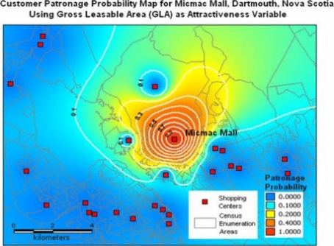
Predicting consumer behavior: Huff Models
Originally, consumer store location probability of choice based on distance and size
Generalizes to different variables
Gravity Model: Probability goes down as distance increases

Slide 36
Space-Time, A new and promising area in GIS, which is now available for personal use
Mostly GIS has been used to map and analyze phenomena at a single time point.
“Space-Time” refers to new capabilities in GIS that enable the tracing of events over time as well as space.
  An example would be to trace a person’s routing throughout the day in 3-D.
  Another example would be to check on mapping of the world’s nations over time.
    Gapminder (www.gapminder.org) is a free, user-friendly GIS software service that allowing tracking of worldwide mapped information over time. This capability will be built into ArcGIS Professional (winter 2015)
  Space-Time could be used for travel, investments, real estate, reports, and other personal uses.

Slide 37
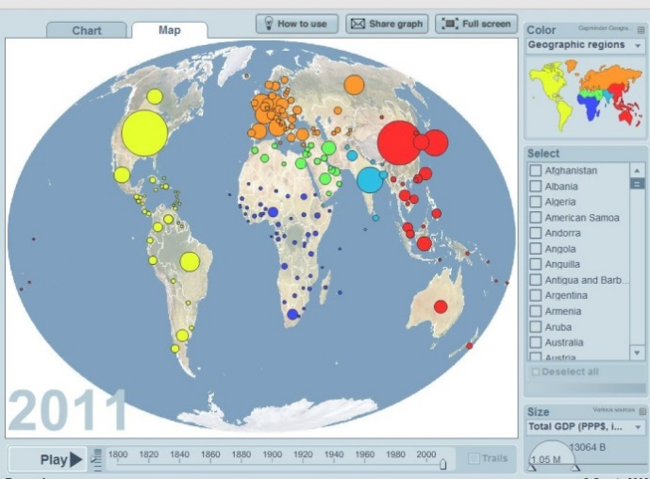
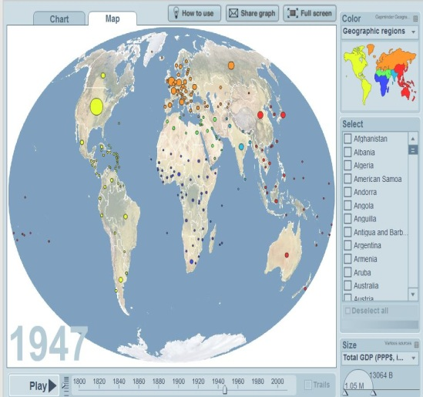
Example: Space-Time Trend Analysis of GDP
Add a temporal dimension to the analysis
Create different snapshots or use a time slider to achieve visualization of change.
Create animated interactive maps
GDP by Country, 1947
GDP by Country, 2010
Source: GapMinder (2014) “GapMinder, for a Fact-based World View”, Software Service. Stockholm, Sweden: GapMinder Foundation. Available at http://www.gapminder.org/

Slide 38
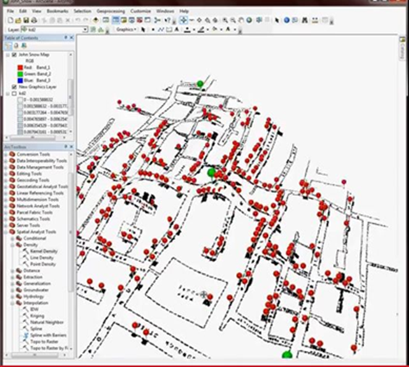
3D Models
Using elevation models with vector layers (e.g. roads, water bodies, cities)
In this example, the roads and other features of 1854 London at the time of the Cholera outbreak appear in 3D
Next Slide
  Can highlight attribute date with 3D Can build urban models for
    Planning
    Line of sight

Slide 39
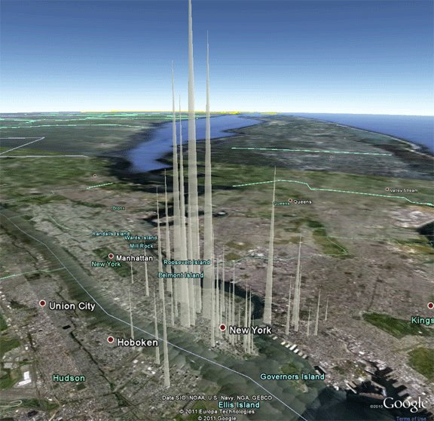
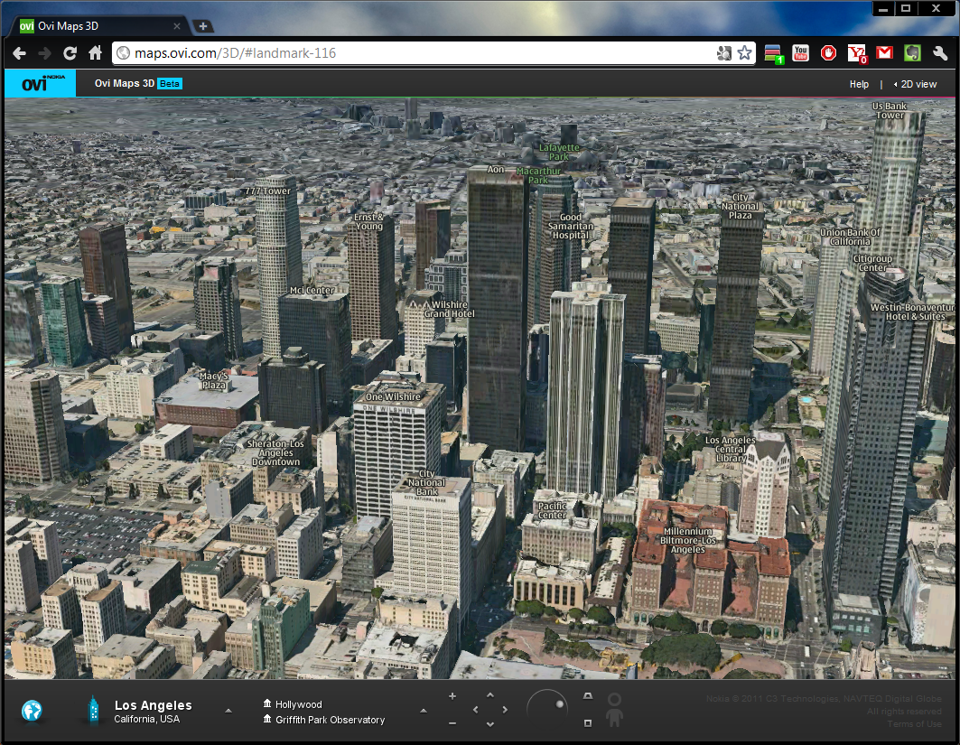
3-D – Starbuck’s check-ins and Los Angeles
Source: GIS Lounge (2011), “Data Appeal: 3D Visualization of GIS Data”, URL:http://www.gislounge.com/data-appeal-3d-visualization-of-gis-data/, December 5, Retrieved July, 15, 2014
River City GIS, “Ovi Maps 3D is Unreal”, URL: http://rivercitygis.com/?p=42,
Retrieved, July 15, 2014

Slide 40
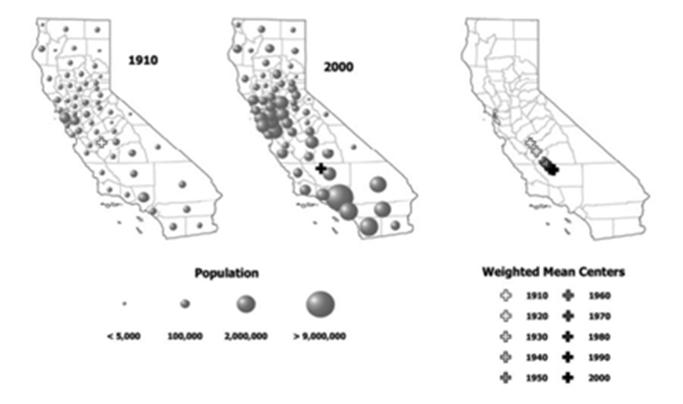

Spatial Statistics
Spatial Cluster Analysis
Spatial Auto-corrrelation
LISA (local indicators of spatial association)
Geographically weighted regression
Hot spot analysis
Kryging
Spatial Econometrics
CA, weighted mean center of population, by county, 1910 through 2000

Slide 41
Example: k-means cluster analysis with mapping
Utilizes a set of attributes to divide up a sample into separate clusters of cases that are related to each other.
The clusters can be mapped thematically (i.e. shadings indicate different cluster membership).
The clusters can be characterized and interpreted.
Clusters can be constrained to be geographically contiguous (option available in ArcGIS 10.2)
Benefit. This exploratory technique shows how groups of attributes are arranged in space. It is often used in marketing, and forms the basis for geo-demographics.

Slide 42
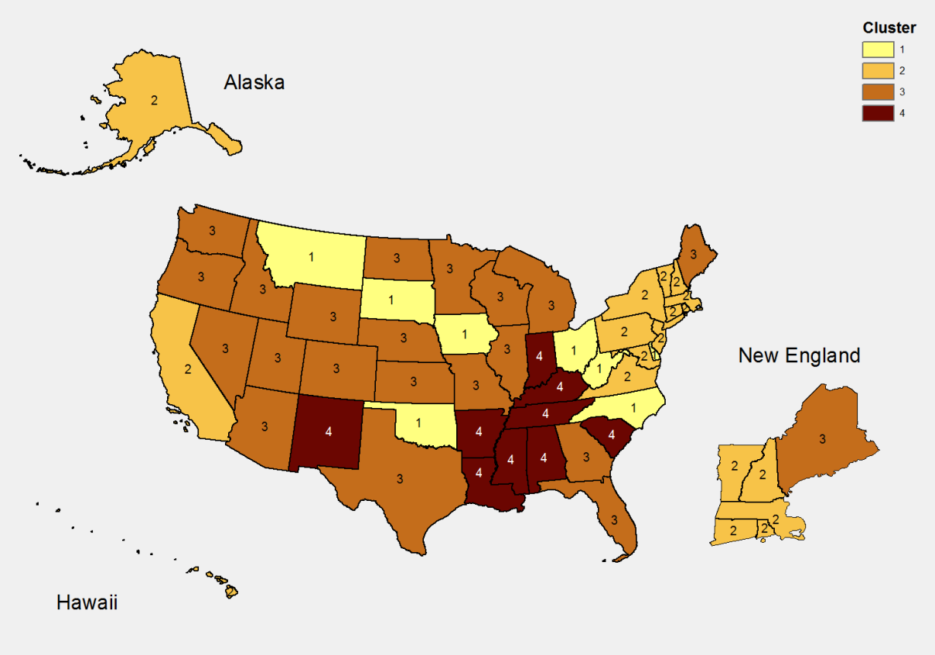
K-means clusters of technological levels of U.S. states, 2010
Cluster 1. Intermediate ICT usage level.
Cluster 2. High ICT usage level.
Cluster 3. Highest ICT usage level.
Cluster 4. Lowest ICT usage level.
(Source: Pick, Sarkar, and Johnson, 2014.)

Slide 43
Summary
GIS differs from standard analytics by adding a spatial dimension to objects.
Almost any business object can be spatially referenced.
Spatial analysis, statistics, and modeling can be applied to spatial objects.
Today’s GIS is heavily influenced by the web, mobile platforms, big data, and social media.
Spatial analysis and GIS constitute a large and rapidly growing economic sector.
Spatial concepts, features, and analysis capabilities are varied and can improving business efficiency and decision-making.

