Slide 1



rKnowledge
The Spatial Diffusion of rDNA Methods
Maryann P. Feldman UNC, Department of Public Policy
Dieter F. Kogler UCD, School of Geography,
Planning & Environmental Policy
David L. Rigby UCLA, Departments of Geography & Statistics

Slide 2
RESEARCH OBJECTIVES
To examine the spatial diffusion of a new technology across U.S. metropolitan areas
To identify & measure the roles of cognitive proximity, social proximity & geographical proximity in the diffusion process

Slide 3
MOTIVATION
Long history of geographical work on diffusion
  Hagerstrand, Pred, Brown
Renewed interest in the diffusion of knowledge connected to uneven development/regional economic growth (is knowledge fixed in space / how does it flow/does mobility reduce its value?)
  Polanyi, Griliches, Gertler
Debates over the relative roles of social proximity & spatial proximity in knowledge flow
  Jaffe et al., Breschi & Lissoni, Boschma, Singh, Fischer et al.

Slide 4
OUTLINE
rDNA technology: the Cohen-Boyer patent
Diffusion of rDNA technology across U.S. cities
A simple model of diffusion
  Knowledge space & measures of cognitive proximity
  Measuring the social proximity of cities
  Measuring the spatial proximity of cities to rDNA
Results
Conclusion

Slide 5

RECOMBINANT DNA
Cohen-Boyer patent
  Stanley Cohen, Stanford
  Herbert Boyer, UCSF
Patent application – November 1974
Patent granted – December, 1980
Why the time lag?
  Scientific moratorium – Asilomar Conference, 1975
  Supreme Court ruling – Diamond vs. Chakrabarty, 1980
  Bayh-Dole Act – December, 1980

Slide 6
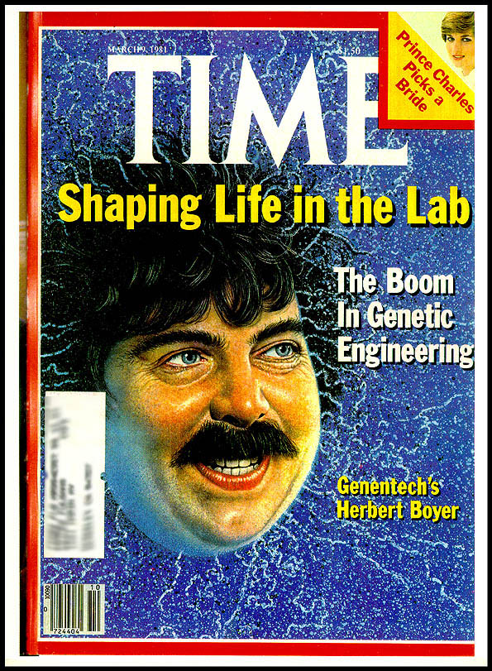
THE OUTCOME
Perhaps the most successful university technology licensing program
  468 firms license technology from Stanford
  Licensing revenues equal $255 million, from $35 billion in worldwide product sales
  Fundamental technology jumpstarts biotechnology industry

Slide 7
rDNA PATENT APPLICATIONS & COUNTS OF MSAs WHERE INVENTORS RESIDE, 1976-2005

Slide 8
KEY CITIES OF rDNA INVENTION

Slide 9
A MODEL OF rDNA DIFFUSION
Development of an rDNA patent
Function of:
Geographical Proximity
Social Proximity
Cognitive Proximity
some covariates
=

Slide 10
COGNITIVE PROXIMITY (to Cohen-Boyer)
Cohen-Boyer is defined as a technological class (1 of 439) in patent records
Have to find distances between technological classes
  Look at patent co-classification
  Use probability of co-classification to estimate inter-class distances
Visualizations of technological classes & distance between them
Cognitive proximity of a city to Cohen-Boyer given by average proximity (inverse distance) of all patents in the city to C-B (this not great?)

Slide 11
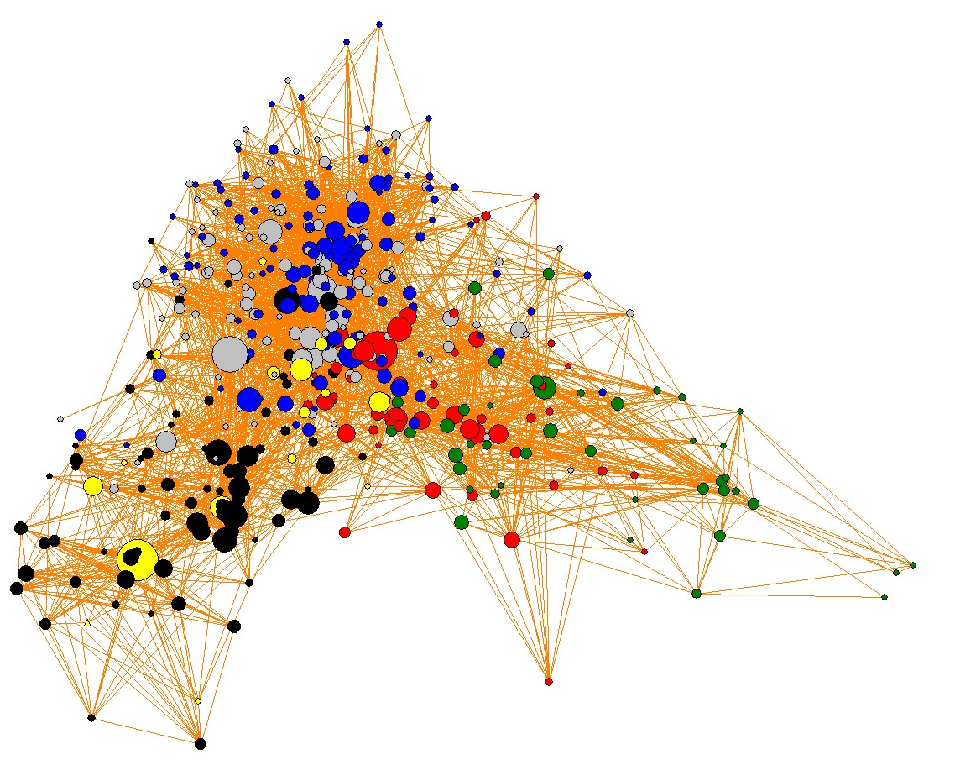
U.S. KNOWLEDGE SPACE
1980
Chemicals
Computers & Communic.
Drugs & Medical
Electronics
Mechanical
Miscellaneous
435/69.1

Slide 12
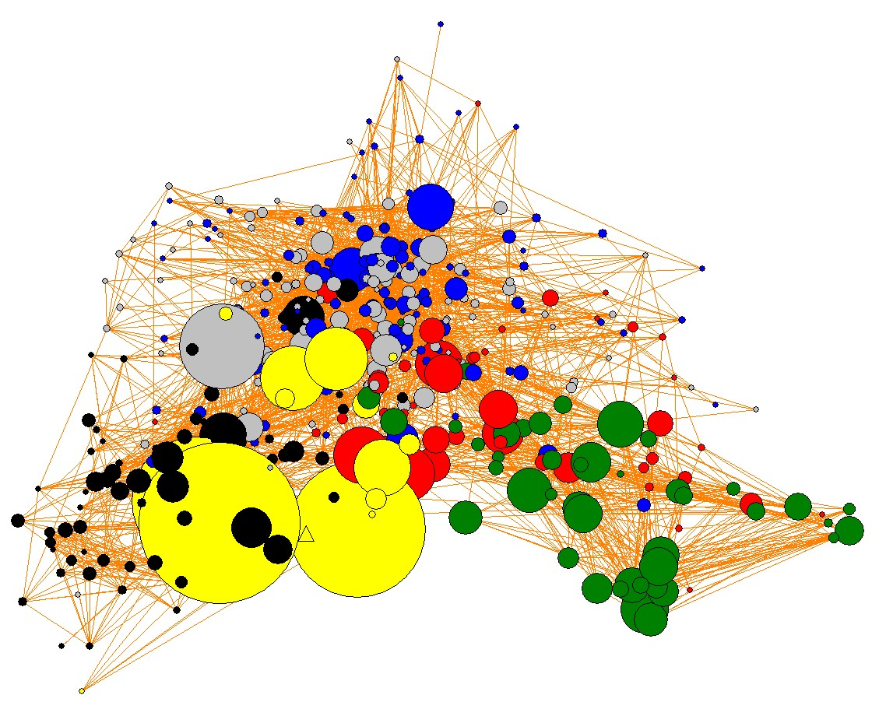
U.S. KNOWLEDGE SPACE
1995
Chemicals
Computers & Communic.
Drugs & Medical
Electronics
Mechanical
Miscellaneous
435/69.1

Slide 13
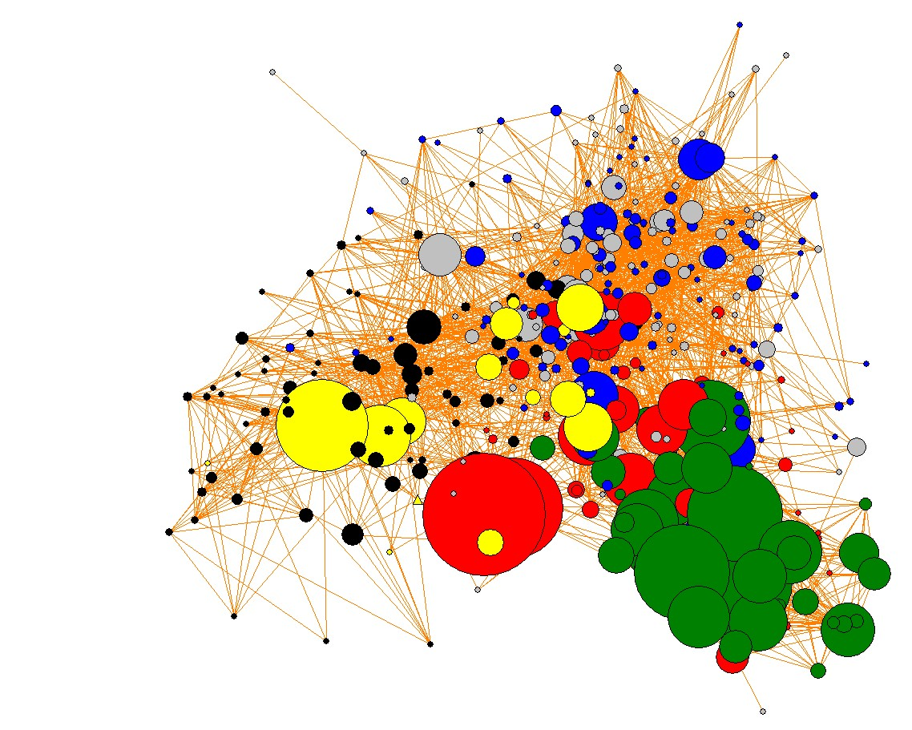
U.S. KNOWLEDGE SPACE
Chemicals
Computers & Communic.
Drugs & Medical
Electronics
Mechanical
Miscellaneous
2005
435/69.1

Slide 14
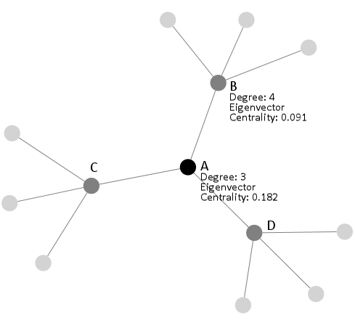
SOCIAL PROXIMITY
(to C-B)
Construct annual lists of co-inventors on CB patents
Construct lists of co-inventors of CB co-inventors
366x366 matrix of MSAs
Populate with 0s
Add 1 to cells i & j when a pair of CB co-inventors is located in cities i & j
Add 0.5 to cells i & j when there is a non-CB co-inventor relationship in i & j
Find centrality of each city

Slide 15
GEOGRAPHICAL PROXIMITY (3 bites)
Take co-ords of each city & build distance matrix (366x366)
Row sum yields city proximity (inv. dist.) measure to other cities
Bite 1
Multiply distance matrix for cities (366x366) by (366x1) vector of presence/ absence of CB in each city in each time period yields overall distance to Cohen-Boyer
0/1
(366x1)
City
Access to C-B
(366x1)
Bite 2
X
=
Take minimum distance measure to CB from Bite 2 (366x1)
Bite 3

Slide 16
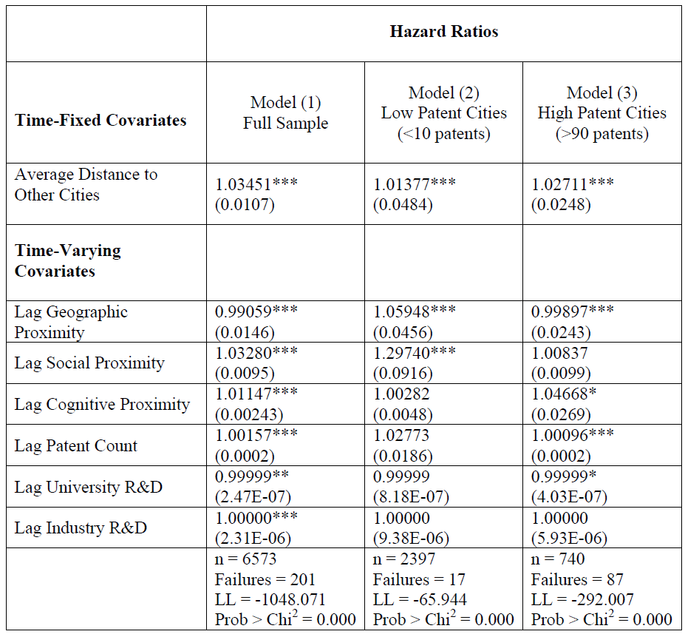
RESULTS 1:
Event
History
Model
Dependent variable is time (# years from 1980) to a city developing first C-B patent

Slide 17
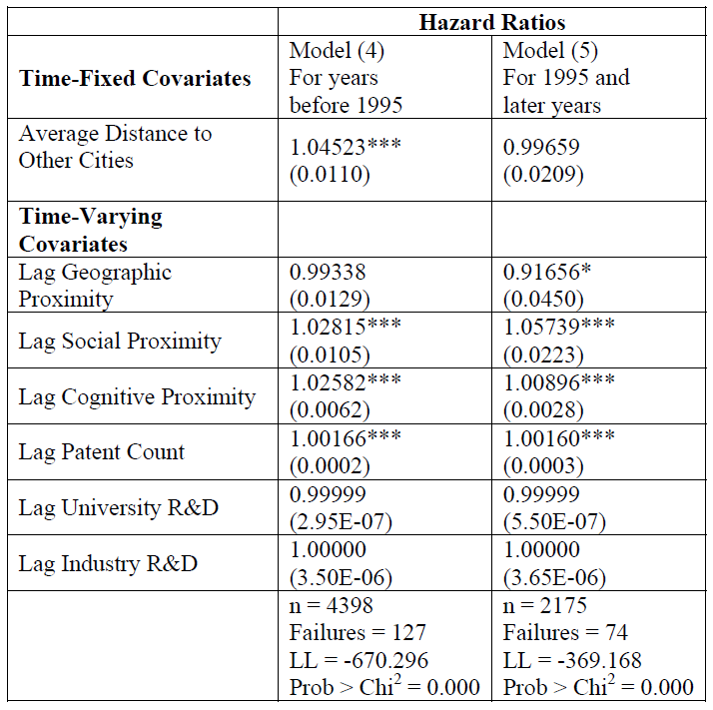
RESULTS 2:
Event
History
Model for Different Periods

Slide 18
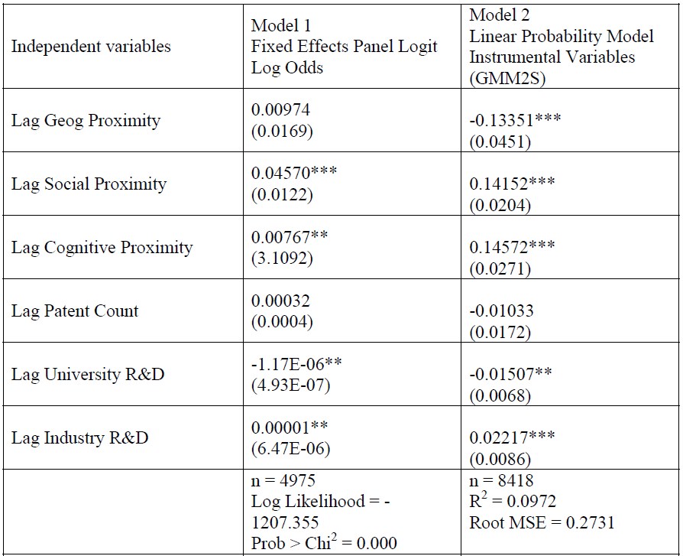
RESULTS 3:
FIXED EFFECTS PANEL LOGIT
Dependent
variable – does city develops a
C-B patent in
year
Model run with time-fixed effects

Slide 19
CONCLUSION
From the hazard model, social proximity & cognitive proximity exert a positive & significant impact on the probability that a city develops a first Cohen-Boyer patent.
Influence of geographical proximity mixed, reflecting changing nature of diffusion over time (first hierarchical, then epidemic)
City-size and industry R&D have similar positive impacts, while increases in university R&D reduce the probability of a C-B patent?

Slide 20
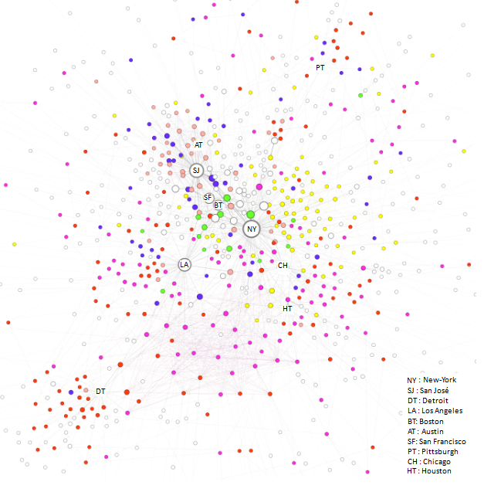

Slide 21
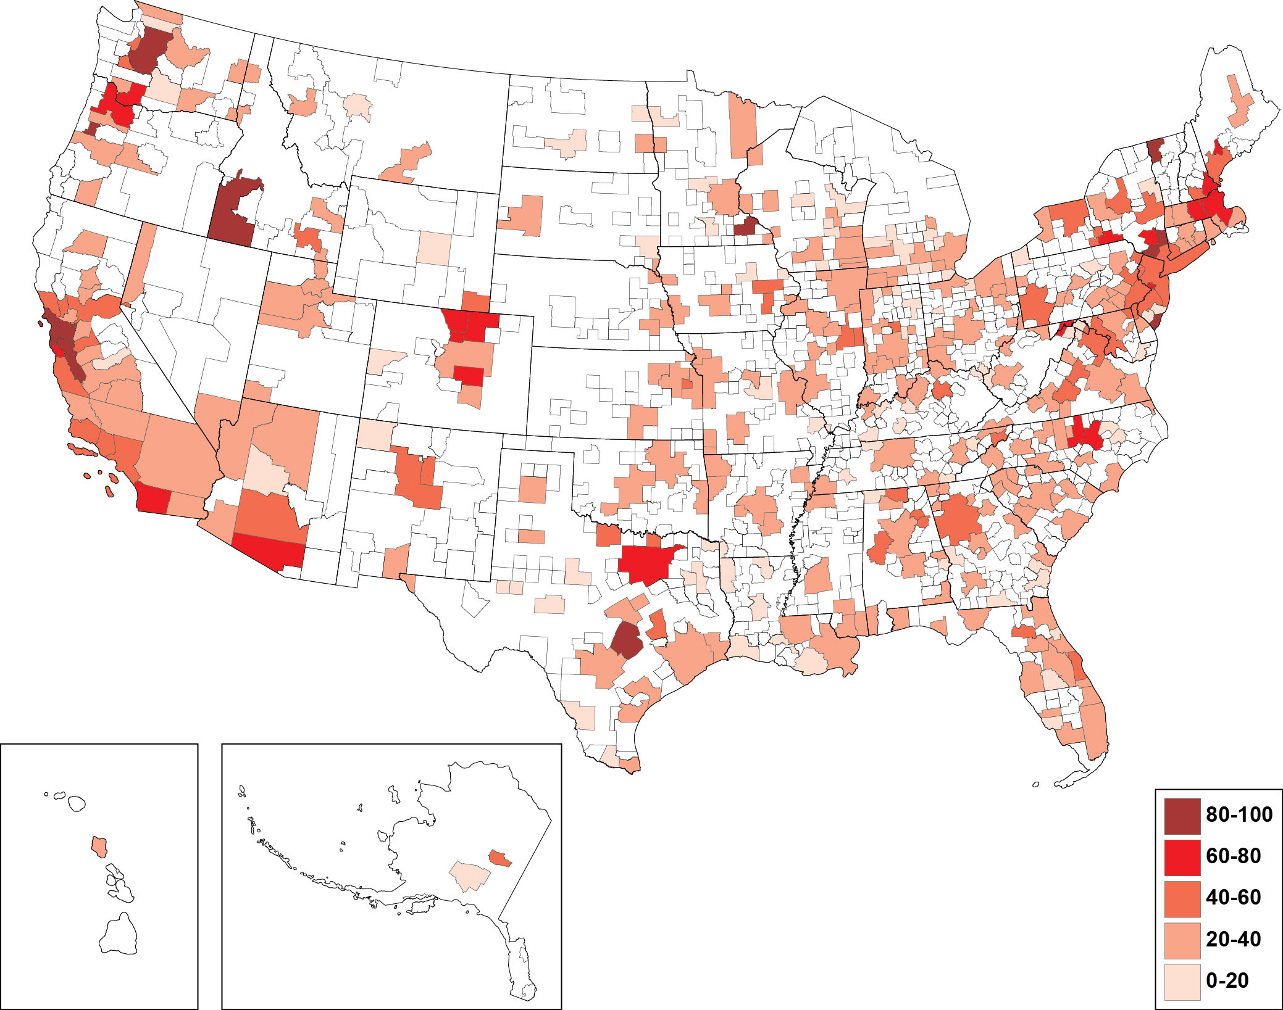

Slide 22
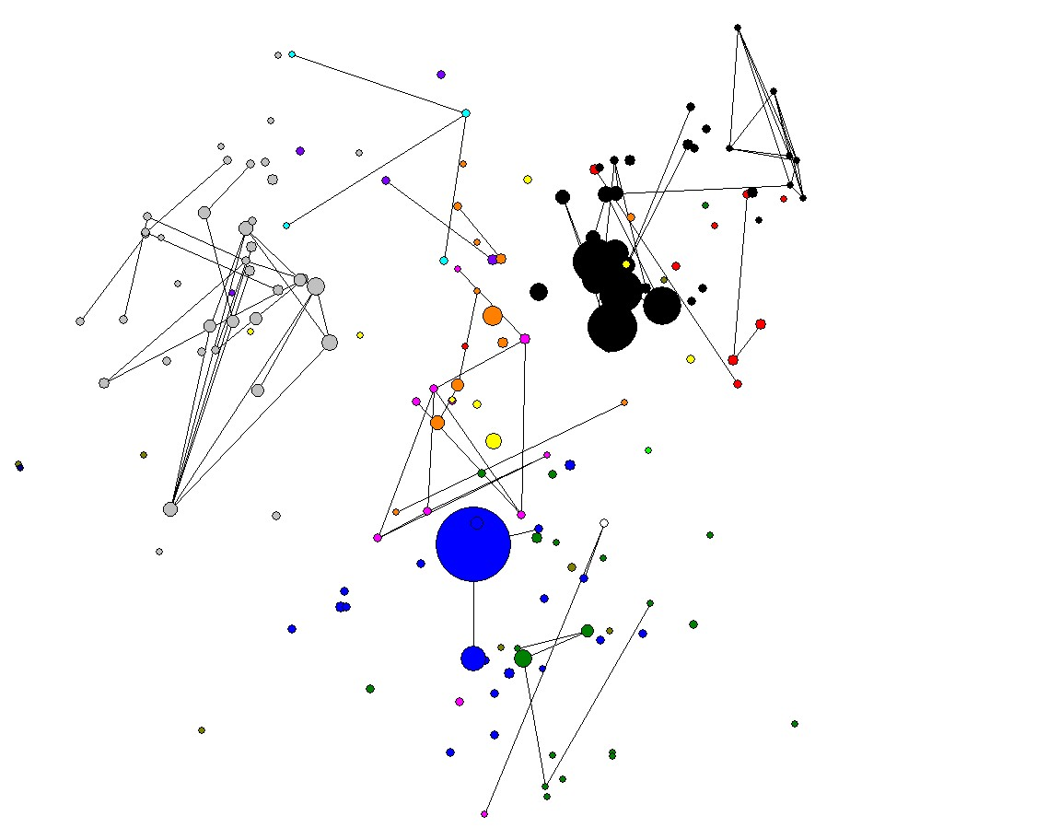

Slide 23
